Slide 1


INTRODUCTION to TEAM MODULE 5
CONNECTICUT STATE DEPARTMENT OF EDUCATION
The Connecticut Code of Professional Responsibility for Educators
Regulations of Connecticut State Agencies
Section 10-145d-400a

Slide 2

As public service employees, educators hold a special position of trust.

Slide 3
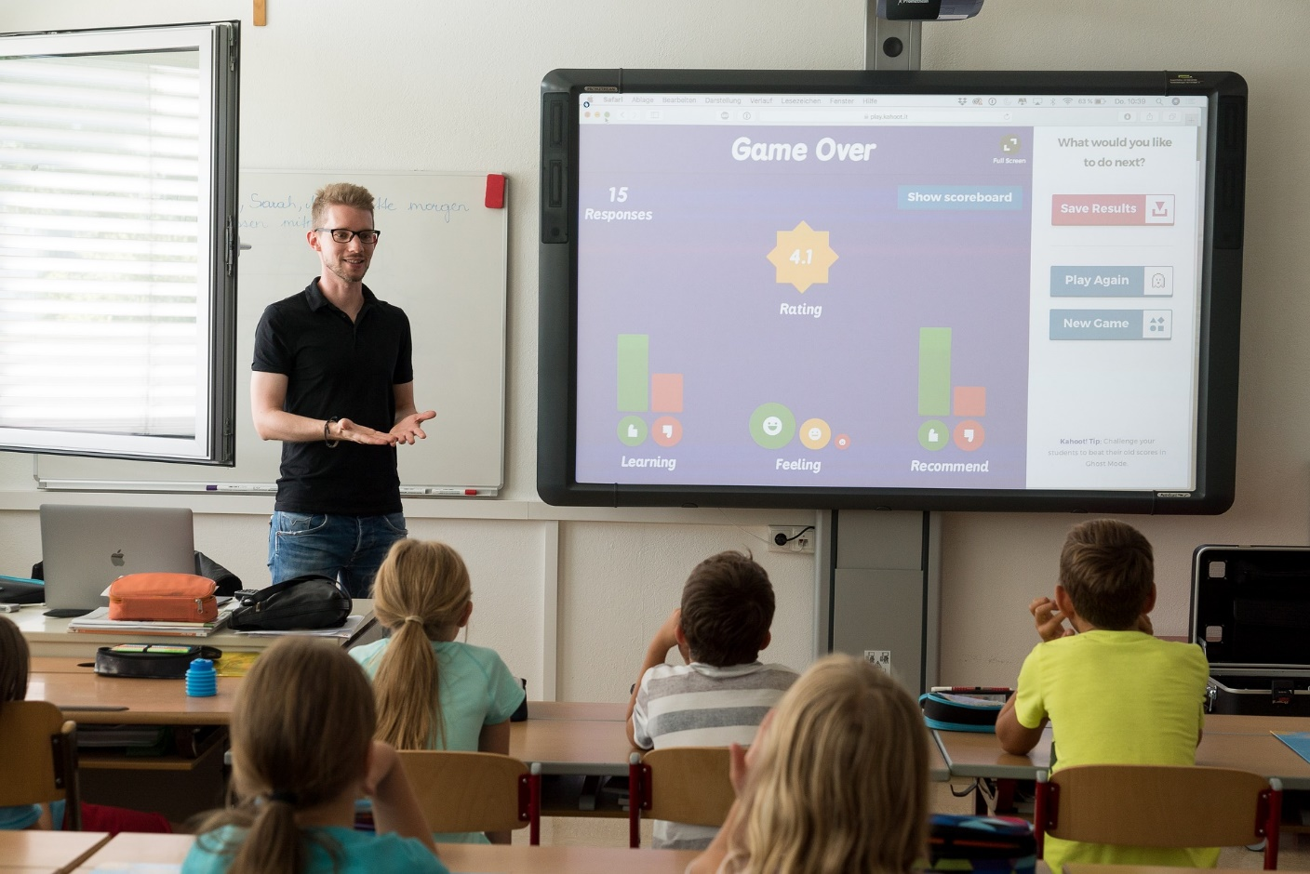
Teachers serve as role models who should recognize that their conduct, both on and off the job, can profoundly impact their professional image.

Slide 4

Educators exercise powers that have a significant impact on the lives of children and young people.

Slide 5

Consequently, there is a community
expectation that these powers will be properly and prudently used.

Slide 6

The teaching profession is vested by the public with a trust and responsibility requiring the highest ideals of professionalism.

Slide 7

The teacher accepts both the public trust and the responsibilities to practice the profession according to the highest possible degree of ethical conduct and standards.

Slide 8
The Connecticut The Code of Professional Responsibility for Teachers is a set of principles which the education profession expects its members to honor and follow.
It sets the standards to guide conduct and the judicious appraisal of conduct in situations that have professional and ethical implications.

Slide 9
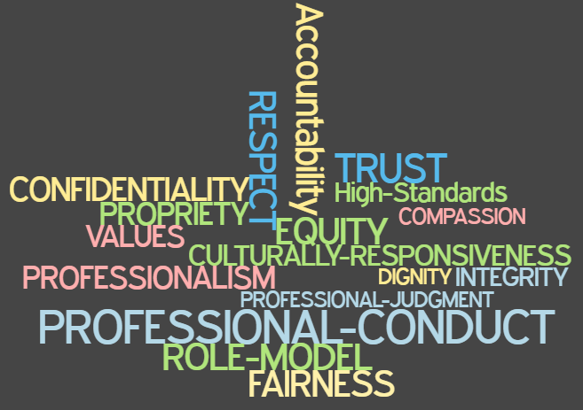
Key words underpinning the code
Notes:
Ask which words stand out.

Slide 10

Educators are expected to practice the profession according to the highest possible degree of ethical conduct and standards.

Slide 11
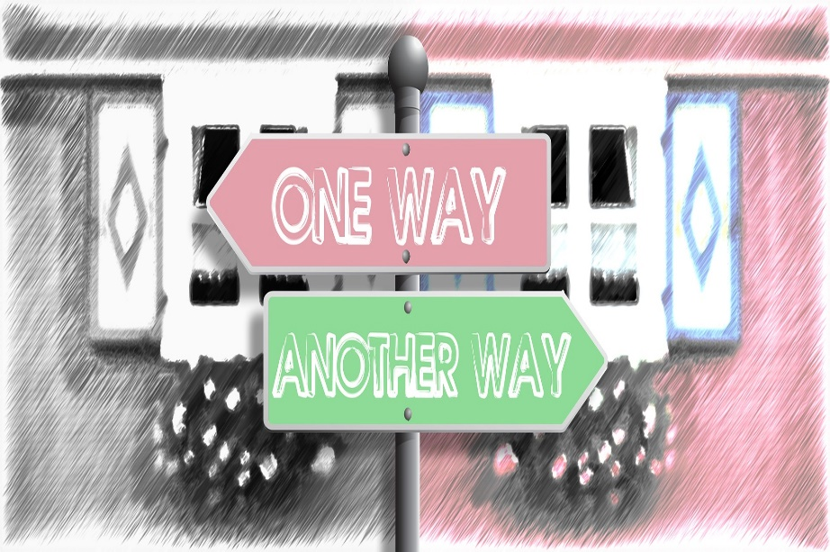
A code of conduct helps us to understand our responsibilities, prioritize our obligations, and find wise resolutions to the ethical dilemmas we may face.

Slide 12
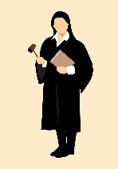


Ethical training has become an important part of the business and professional world.
Attorneys
Physicians
Clergy
Accountants
Therapists

Slide 13

According to Charlotte Danielson, teachers make over 3,000 decisions per day.

Slide 14
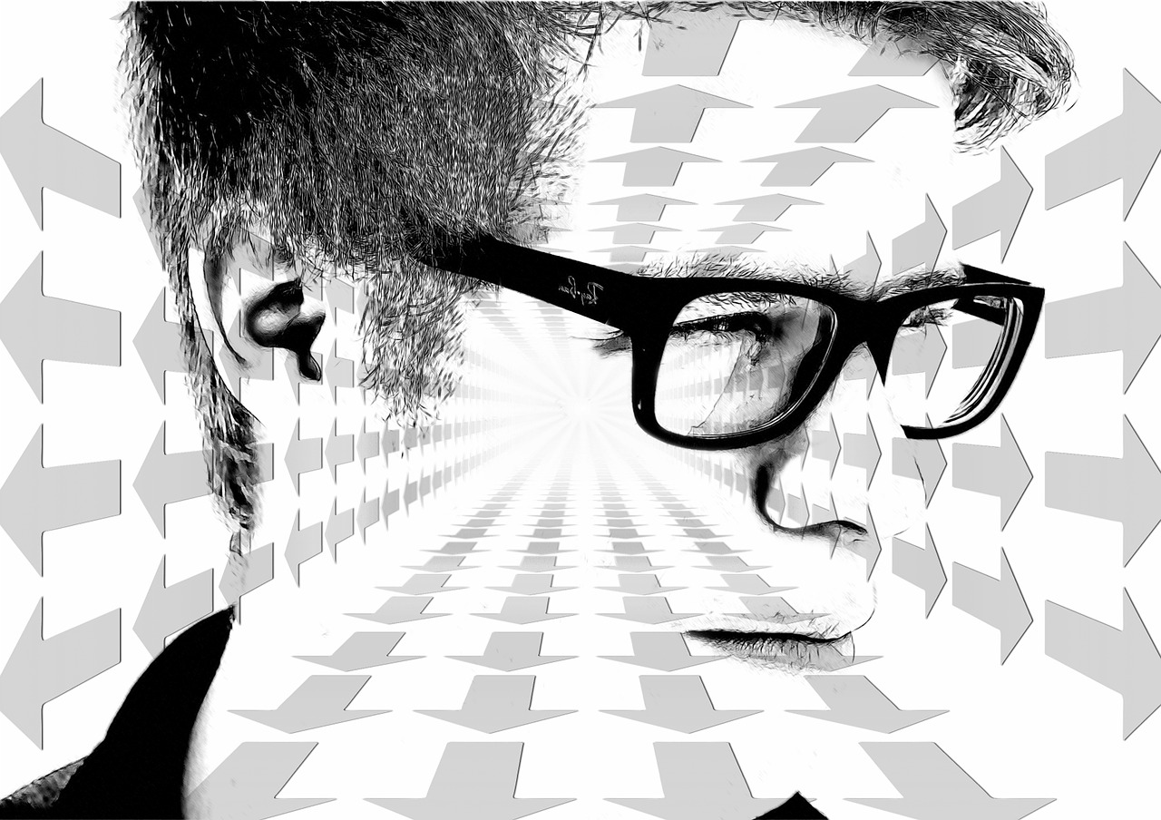
Are teachers prepared to always make the right decision?

Slide 15
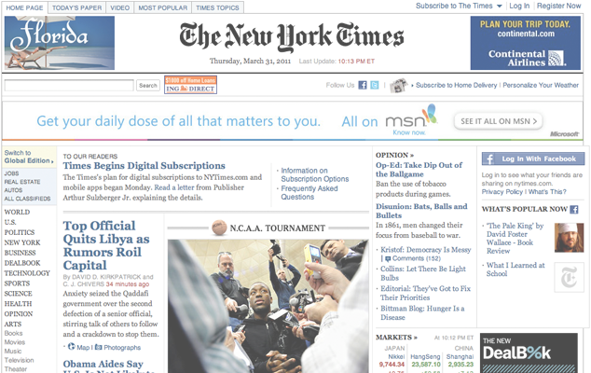
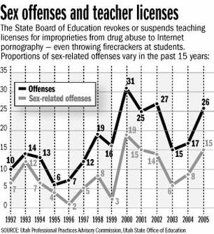
Unfortunately, educator misconduct occurs and is a serious concern for communities, schools, districts and states across the country.
Charges of teacher misconduct are on rise
Published: Saturday, April 22, 2006 12:00 a.m. MDT
Copyright 2006 Deseret Morning News
Teacher Web sites triggering questions
Some are posting personal data that students can access
Published: Saturday, June 10, 2006 12:00 a.m. MDT By Laura Hancock

Slide 16

Not only does it harm our students,
educator misconduct disgraces the community and denigrates the profession.

Slide 17
A code of conduct supports us in doing what is right.
It provides support for behaving ethically
especially
when there is pressure or temptation
to do what is easiest
or
what will make people like us.

Slide 18

Teaching is complex.
Teachers continually shape and reshape their actions to respond to the individual needs of their students.

Slide 19
Developing a positive relationship with students is essential to effective teaching.

Slide 20

When you develop positive relationships with your students, they are more likely to engage academically and achieve more.

Slide 21
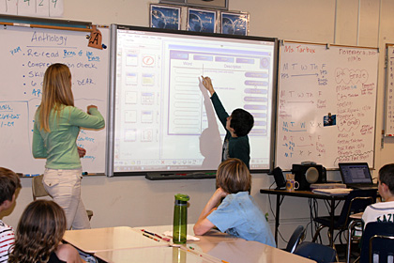
Teachers who foster positive relationships with their students create classroom environments that are responsive to and respectful of the developmental, emotional, and academic needs of students with diverse backgrounds, interests and performance levels.

Slide 22

Marzano (2003) states that students will resist rules and along with the consequent disciplinary actions if the foundation of a good relationship is lacking.

Slide 23

Students are more likely to be emotionally and intellectually invested in classes where they have positive relationships with their teachers.

Slide 24

Students need to feel a sense of comfort and safety from physical and emotional harm. They need to feel they are seen, valued, respected, and heard.

Slide 25

How does a teacher develop positive relationships with students and uphold the
Code of Professional Responsibility for Educators?
Notes:
Schools are
responsible for providing students with a safe environment
in which to develop academically, emotionally and
behaviorally.
make
responsible decisions, establish
positive relationships and
effectively handle challenging
situations.
head off potential conflict

Slide 26

Schools are responsible for providing students with a safe environment
in which to develop academically, emotionally and behaviorally.

Slide 27
Educators develop positive relationships by
making responsible decisions,
effectively handling challenging situations, and
heading off potential conflicts.

Slide 28

Students are very cognizant of a teacher’s attitude towards them, the school
and the class in general.
Teachers must be certain that they are modeling positive behaviors.

Slide 29
Learning about their students’ cultures, languages, and life experiences helps to create a safe space,
and encourages students to feel a sense of belonging.

Slide 30
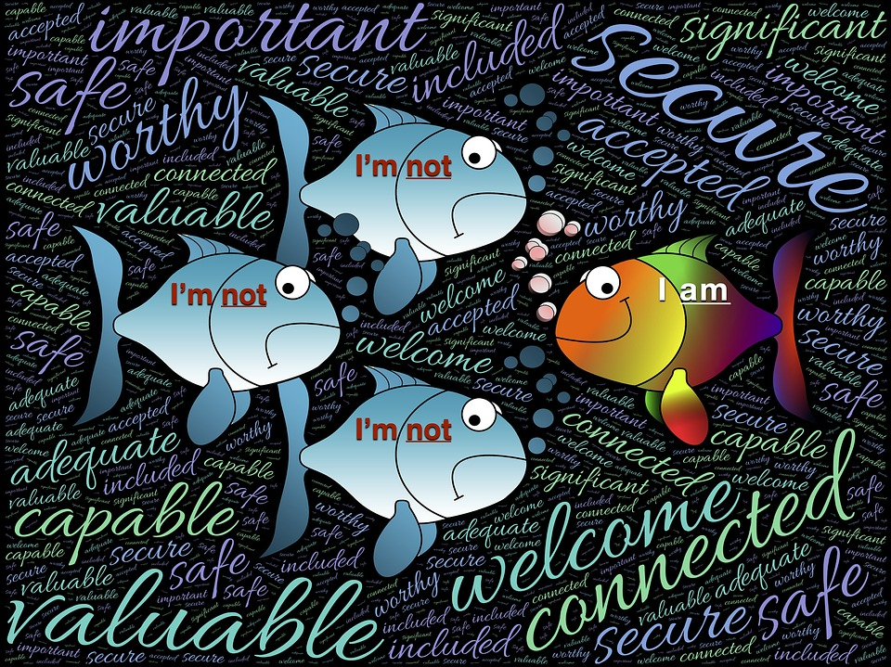
Educator bias can hinder a student’s ability to feel safe in a classroom, making it
difficult for the student to enjoy school or certain classes.

Slide 31

Teachers are expected to use good judgment at all times.

Slide 32

The Code applies at all times.
This includes times when a teacher is not at school and not performing work duties.

Slide 33

Even though an individual’s intent may be purely innocent,
engaging in certain activities with students or in the presence of students
can subject a teacher to possible perceptions of impropriety.

Slide 34

The appearance of unethical behavior can be just as damaging to public confidence in the profession as unethical conduct itself.

Slide 35

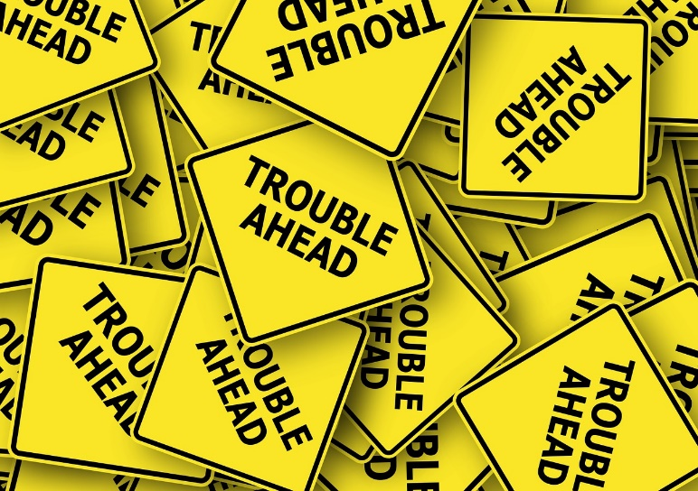
What are some examples of behavior that may cause concern?
Meeting with a student alone, behind closed doors, regardless of gender.
Giving students gifts, rewards or incentives that are not school related.
Touching or having physical contact with students that is unwanted and/or inappropriate.

Slide 36
What are some examples of behavior that may cause concern?
Engaging in personal communications with students, by phone/cell phone, email, internet, texting or in person at any time for purposes that are not specifically related to school.

Slide 37
What are some examples of behavior that may cause concern?
Providing students with your personal home/cell phone number, personal email, home address or other personal contact information, except for specific school-related purposes.

Slide 38
What are some examples of behavior that may cause concern?
Making statements or comments, either directly or in the presence of students, which are not age-appropriate, professional or which may be considered racially biased, sexual in nature, harassing, or demeaning.

Slide 39
What are some examples of behavior that may cause concern?
Engaging in behaviors that are immoral, illegal, unethical, unprofessional or exploitive.
Transporting students in your personal vehicle without proper permission from administrators and parents/family.

Slide 40
What are some examples of behavior that may cause concern?
Taking or accompanying students to any event that is not school related.
Meeting with or being in the company of students at non-school related events.

Slide 41
What are some examples of behavior that may cause concern?
Dealing unjustly and inconsiderately with students
Failure to recognize, respect, and uphold the dignity and worth of students as individual human beings

Slide 42
What are some examples of behavior that may cause concern?
Treating students based on race, ethnic origin, gender, social class, disability, religion, or sexual orientations.

Slide 43

There are boundaries that cannot be crossed.

Slide 44

When allegations of inappropriate conduct or behavior are made, the District is obligated to investigate the allegations, and
if warranted, take appropriate administrative, legal and/or disciplinary action.

Slide 45

What are the consequences of teacher misconduct?
Sometimes a violation of the Code is solely an employment matter and most appropriately handled by the employer;
other times conduct may warrant more severe and significant action.

Slide 46

Consequences of Teacher Misconduct
What are the consequences of teacher misconduct?
Administration imposed discipline
Suspension of employment
Dismissal from employment
Criminal proceedings
Certification denial or revocation
Civil litigation- teachers can be sued as individuals

Slide 47

Benefits of Facilitated Conversations
Following this introduction to Module 5, you and your colleagues will participate in a facilitated conversation to examine several case scenarios in which you will have the opportunity to
share multiple perspectives,
learn from one another,
examine consequences of actions
examine strategies to assure more positive outcomes and
foster professional growth.

Slide 48

The focus of Module 5 is to raise a level of awareness about the Code of Professional Responsibility for Teachers
and to discuss your professional obligations and the potential consequences of actions.

Slide 49

Cases pose questions that draw on the guiding principles or standards of the teaching profession.
Entering into discussions regarding real life ethical situations provides teachers with the opportunity to consider and to reflect on their own professional judgments and actions.

Slide 50

Be a Professional!
Deciding on the right course of action will often involve weighing competing priorities and responsibilities.

Slide 51

Be a Professional!
However, if a teacher is unsure of what to do
discuss the matter in confidence with an appropriate individual such as a supervisor or mentor
seek further advice from a colleague, guidance counselor, social worker, school nurse, etc. depending on the situation

Slide 52

Before proceeding, teachers should ask themselves these questions:
Are my actions potentially harmful to students?
Are my actions consistent with the district’s goals, values, and principles and the Code of Professional Responsibility for Educators?
Are they within the spirit and letter of the law?

Slide 53

Do my actions reflect implicit biases?
Could I adequately defend my actions to my supervisor, the parents/families and the community if the situation was made public?
Is it the right thing for me to do?

Slide 54
What will the outcome of my actions be for
  Students
  The School, the District, and the Community
  Parents/Families
  My Colleagues
  The Teaching Profession
  Others
  ME

Slide 55


“A teacher affects eternity; he can never tell where his influence stops.” -Henry Brooks Adams

