Slide 1


CONNECTICUT STATE DEPARTMENT OF EDUCATION
Resources and Supports for Families during the COVID-19 Pandemic
April 1, 2020

Slide 2


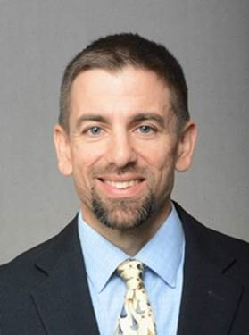
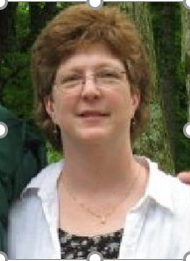
CONNECTICUT STATE DEPARTMENT OF EDUCATION
Bryan Klimkiewicz
Special Education Division Director
Connecticut State Department of Education
Jane Hampton
Acting Executive Director
Connecticut Parent Advocacy Center

Slide 3
Today’s Session
Sharing Information
Sharing Resources
Sharing Contact Information
We are all in this together!
CONNECTICUT STATE DEPARTMENT OF EDUCATION

Slide 4
School Classroom Cancellations
The Governor cancelled all in-person classes to promote social distancing from March 16-March 31.
School Districts were allowed to apply for individual waivers of the 180 school day requirement.
The Governor then waived the requirement for 180 school days for all schools therefore eliminating the need for individual waivers.
Schools began to plan and implement continued educational opportunities for all students.
The Governor then extended the statewide in-person class cancellation through April 20.
CONNECTICUT STATE DEPARTMENT OF EDUCATION

Slide 5
CPAC ACTIVITIES
Facebook –
  Keeping Public Facebook page updated with federal and state guidance. www.facebook.com/cpac/
  New group with resources for supporting your child’s education at home. CPAC Resources and Supports.
  New Spanish group with resources in Spanish for supporting your child’s education at home. CPAC en Español
CONNECTICUT STATE DEPARTMENT OF EDUCATION

Slide 6
CPAC ACTIVITIES
Zoom -
  Interactive Spanish Video chats weekdays at 1pm https://zoom.us/j/902254780
  Presentations in Spanish at 4pm weekly with Q&A https://zoom.us/j/902254780
  Reach Out calls Tuesdays and Thursdays at 10 am https://zoom.us/j/146297152
    What do you need?
    Updated information
    Guest speakers
CONNECTICUT STATE DEPARTMENT OF EDUCATION

Slide 7
BSE Activities
Guidance
  https://www.ed.gov/coronavirus
Resources
  https://portal.ct.gov/SDE/COVID19/COVID-19-Resources-for-Families-and-Educators
Support
  860-713-6910
    Jay Brown, BSE Consultant (jay.brown@ct.gov)
    James Moriarty, BSE Consultant (james.Moriarty@ct.gov)
CONNECTICUT STATE DEPARTMENT OF EDUCATION

Slide 8
Continued Educational Opportunities
Equity
Individualized
Specialized Instruction and Related Services
Planning and Placement Team Meetings
Annual Reviews
Reevaluations
Initial Evaluations
CONNECTICUT STATE DEPARTMENT OF EDUCATION

Slide 9
Thank You! – Be Safe!
Bryan Klimkiewicz
Special Education Division Director
Connecticut State Department of Education
Phone: 860-713-6910
Email: Bryan.Klimkiewicz@ct.gov
Jane Hampton
Acting Executive Director
Connecticut Parent Advocacy Center
www.cpacinc.org
Phone: 860-739-3089
Email: jhampton@cpacinc.org

