Slide 1




ADDRESSING OPIOIDS IN CT
dmhas
liveLOUD
osac
7.09.24

Slide 2

BEHAVIOR CHANGE CAMPAIGN
the goal
reduce opioid overdose deaths in Connecticut
promote recovery from addiction
harm reduction strategies
treatment pathways including MOUD
reduce stigma

Slide 3
BEHAVIOR CHANGE CAMPAIGN
key audiences
Individuals struggling with opioid addiction
or at risk of opioid overdose and death
Friends and family
Stakeholders, professionals, community leaders
Treatment professionals, providers, first responders
Connecticut communities

Slide 4
ADDRESSING OPIOIDS IN CT
changing behavior in a complex crisis

Slide 5
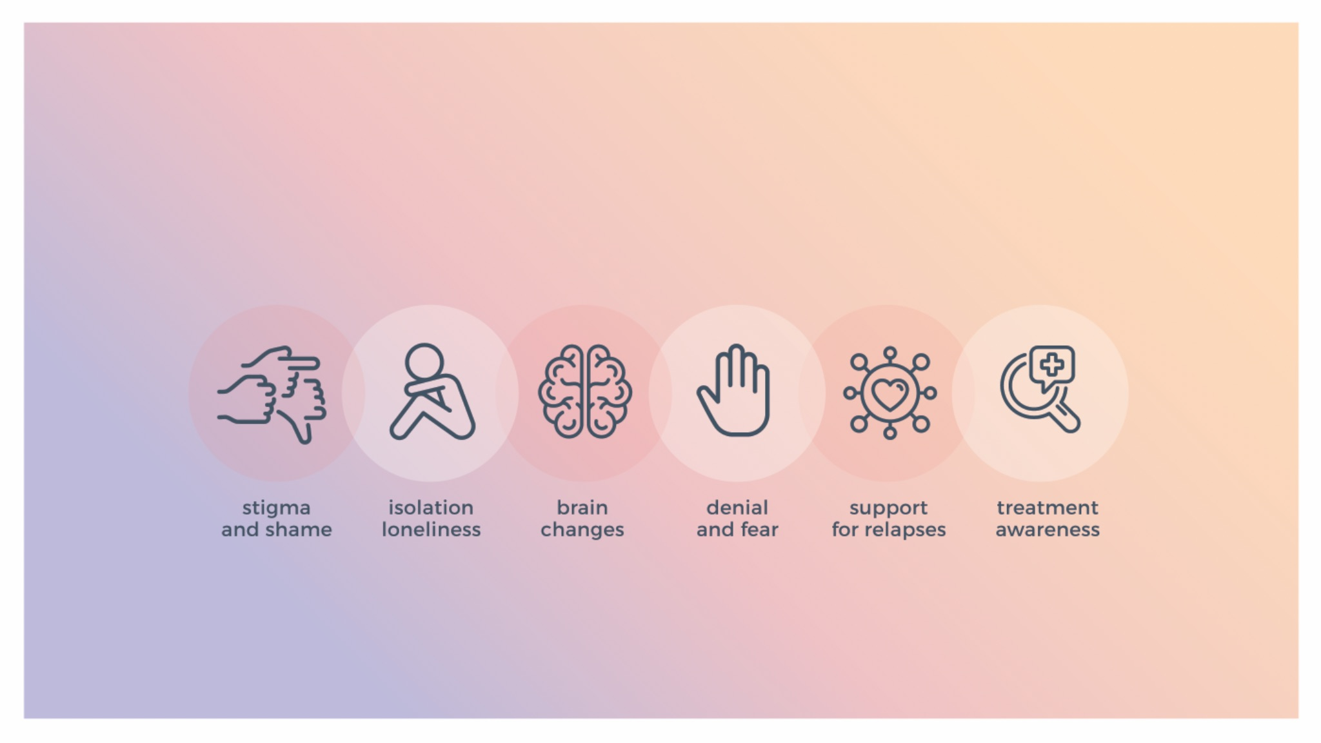
barriers

Slide 6
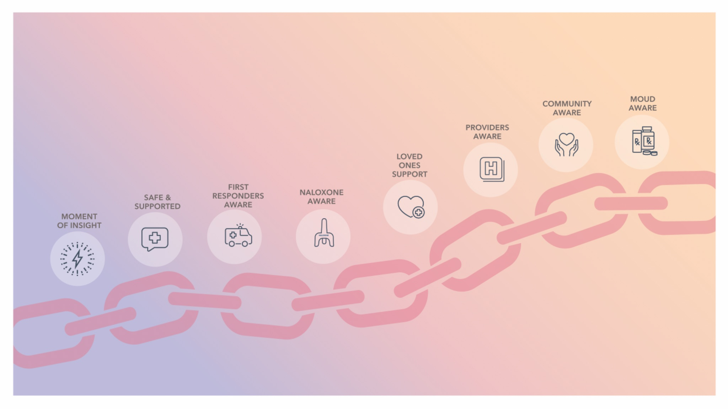
a connected
chain

Slide 7
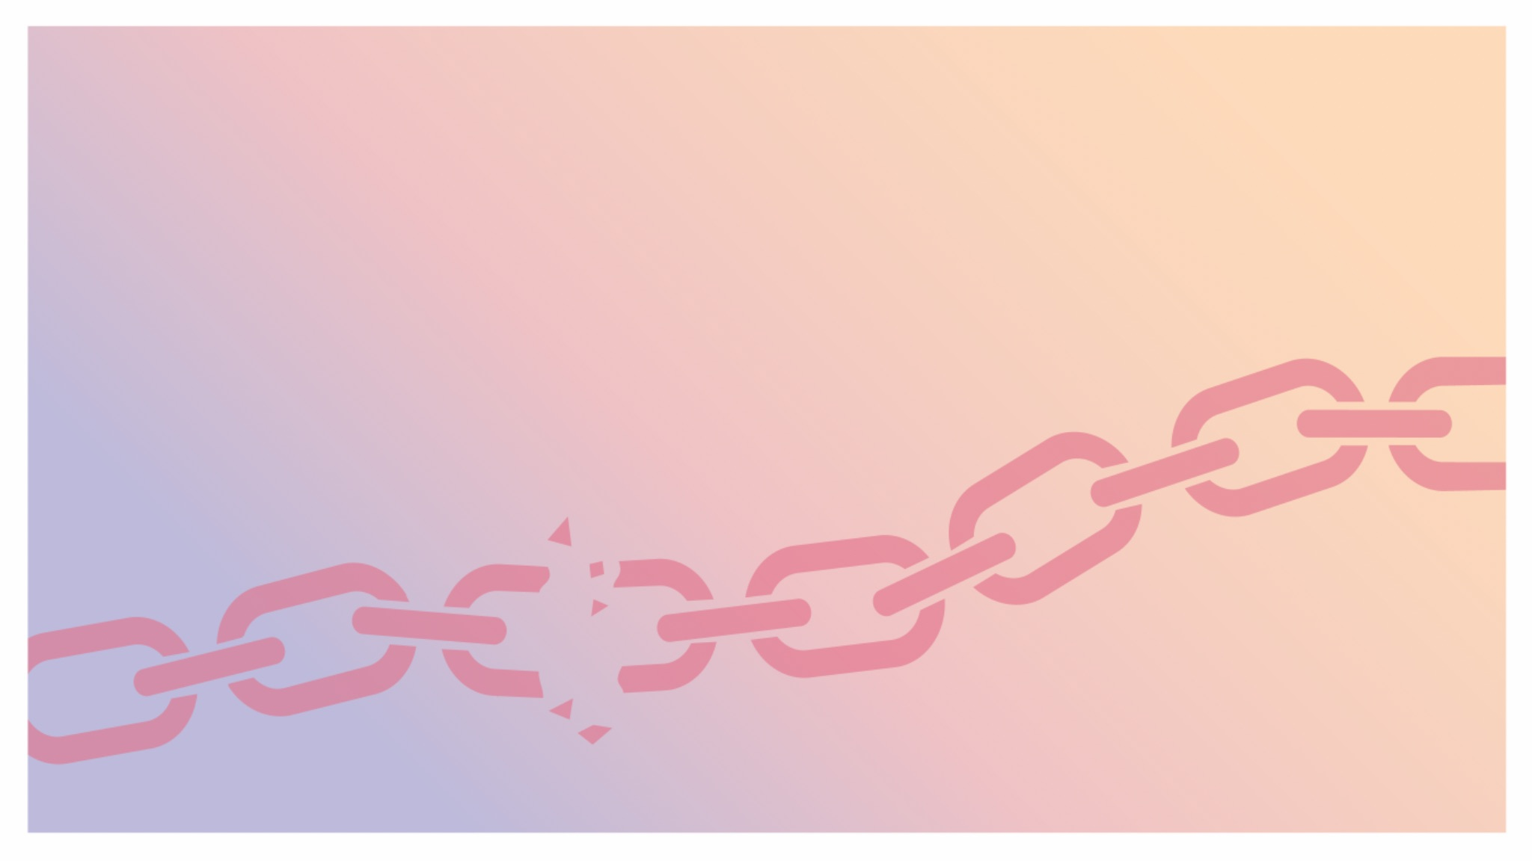
a connected
chain

Slide 8
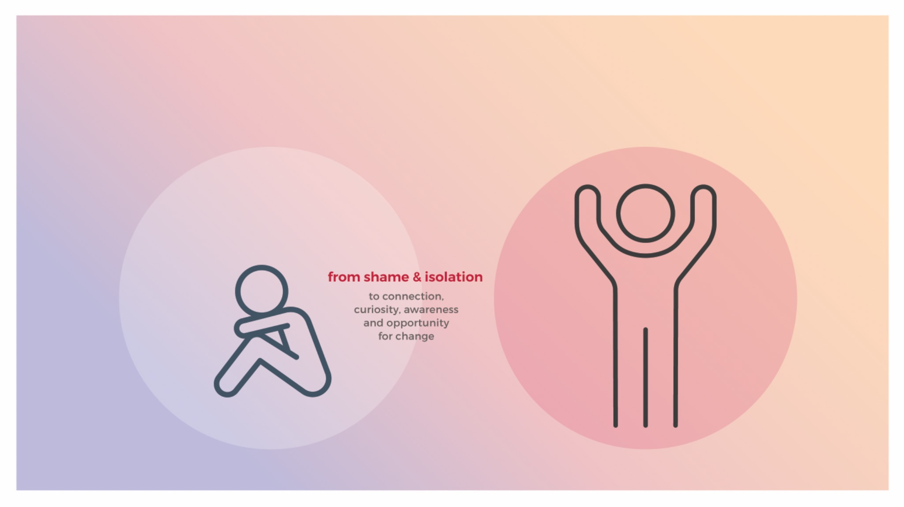
the individual

Slide 9
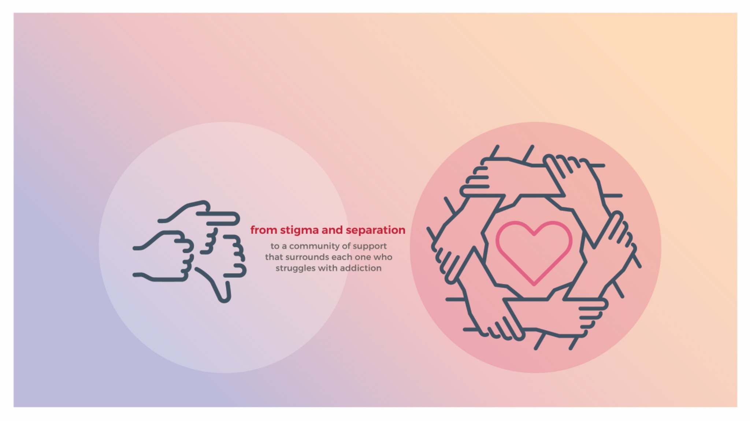
the community

Slide 10
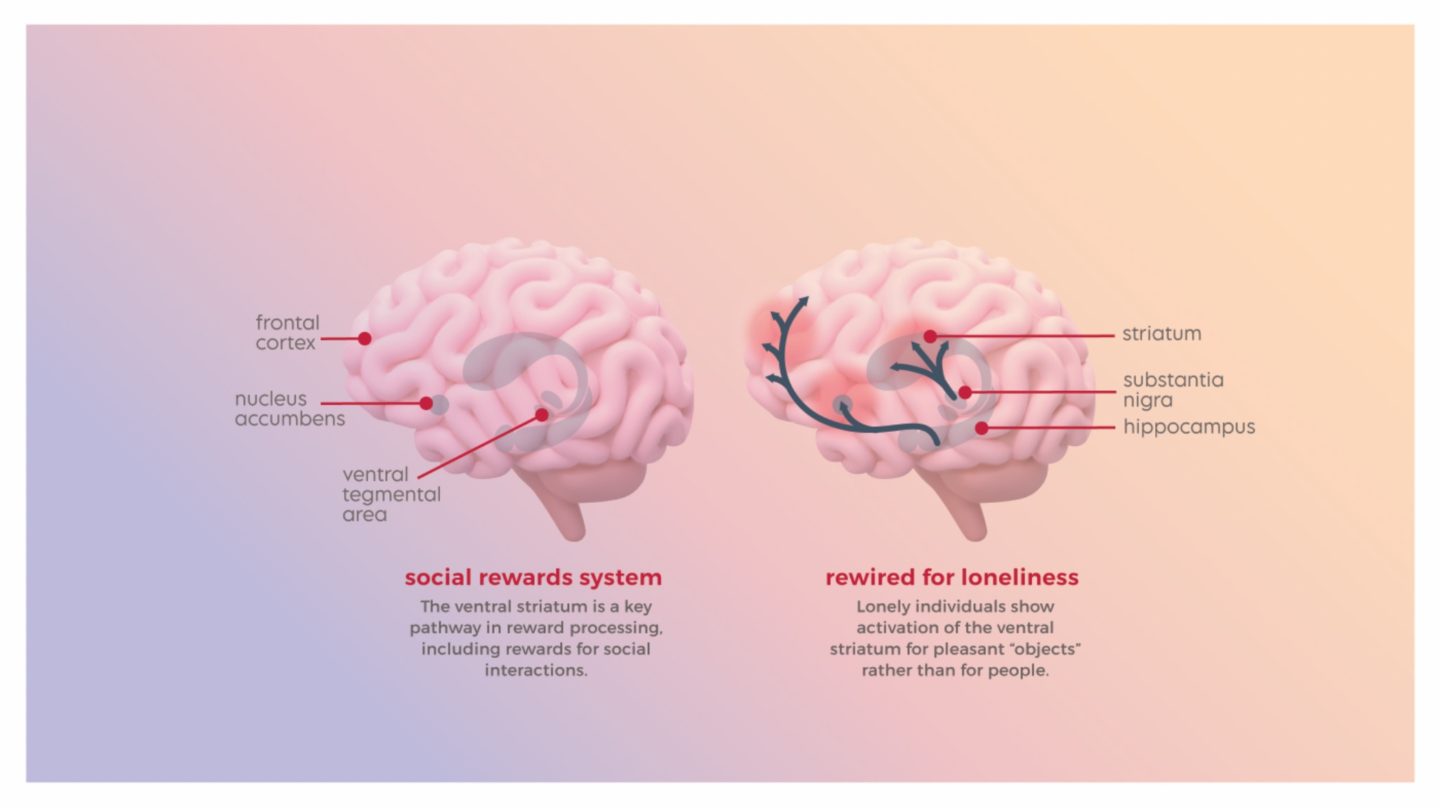
stigma & isolation kill

Slide 11
behavior change
connect
relate with the audiences. brand connects with audiences to create community
share
build awareness by sharing highly accessible information and resources
inspire
inspire action and reward the action; provide small, inclusive steps towards change
support
support audiences through the journey; create space for relapse and keep hope

Slide 12
previous
liveLOUD campaign

Slide 13



liveLOUD
7.4m
total
impressions
one month
bridgeport
hartford
new haven

Slide 14

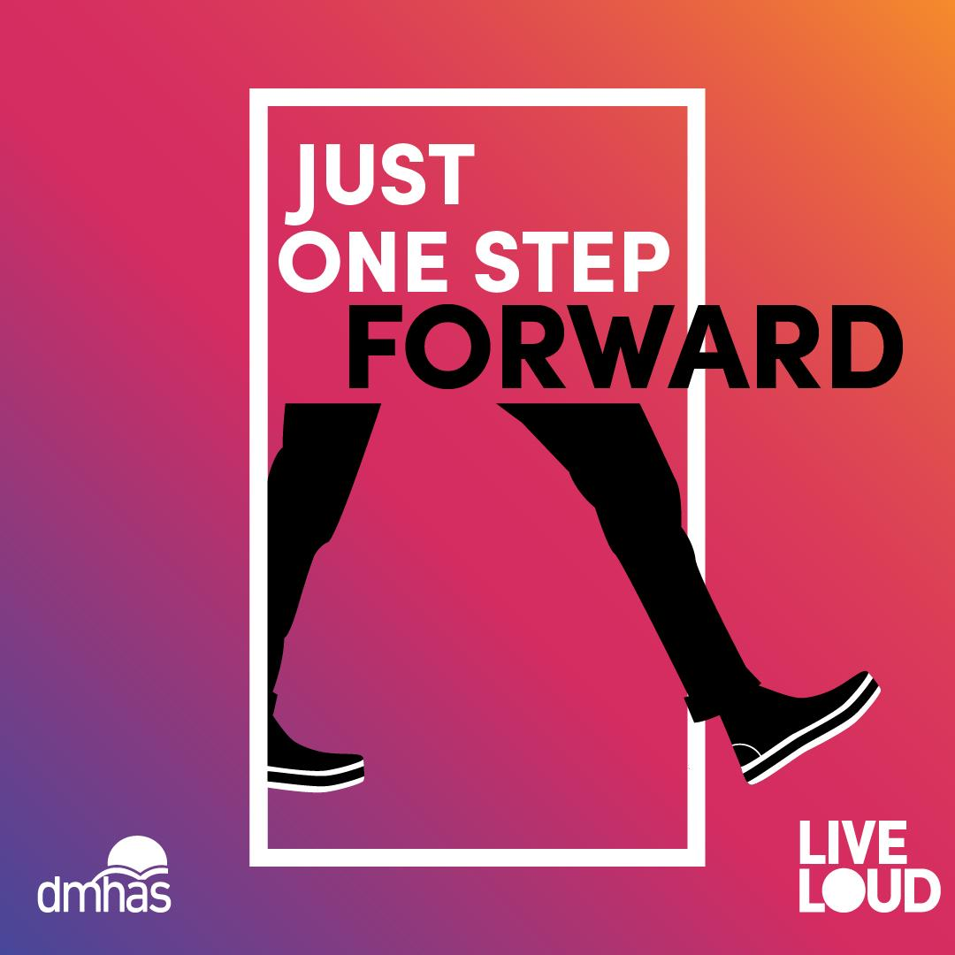

liveLOUD
952k
campaign
engagements
results
engagement: 16,818
impressions: 48,100
reach: 20,912
results
engagement: 19,653
impressions: 51,234
reach: 18,848
results
engagement: 16,546
impressions: 46,002
reach: 16,668

Slide 15
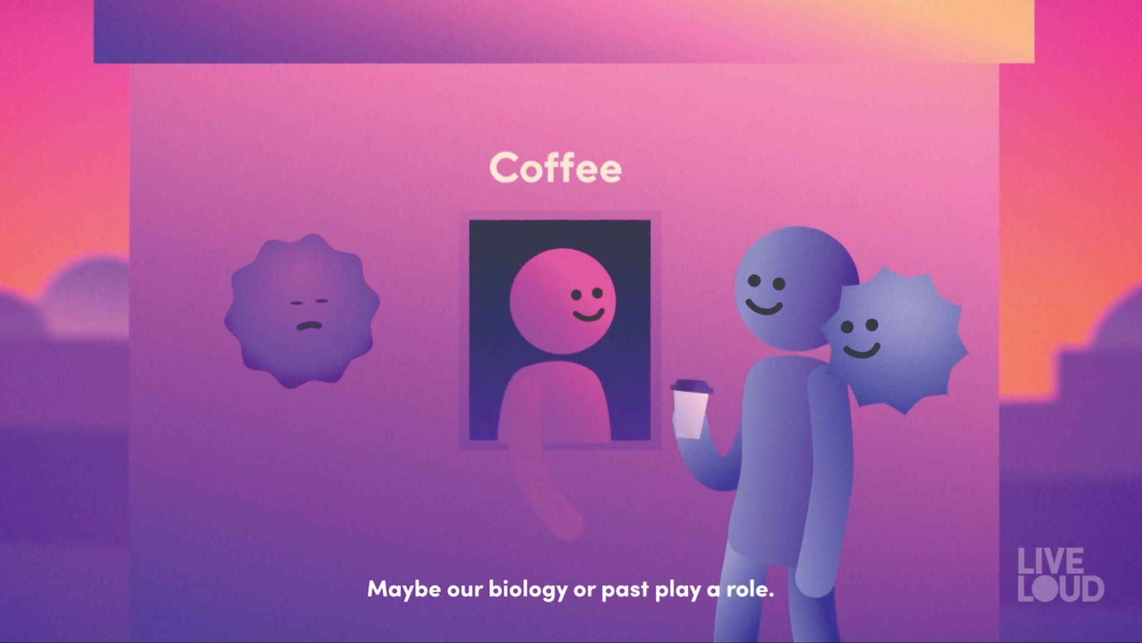

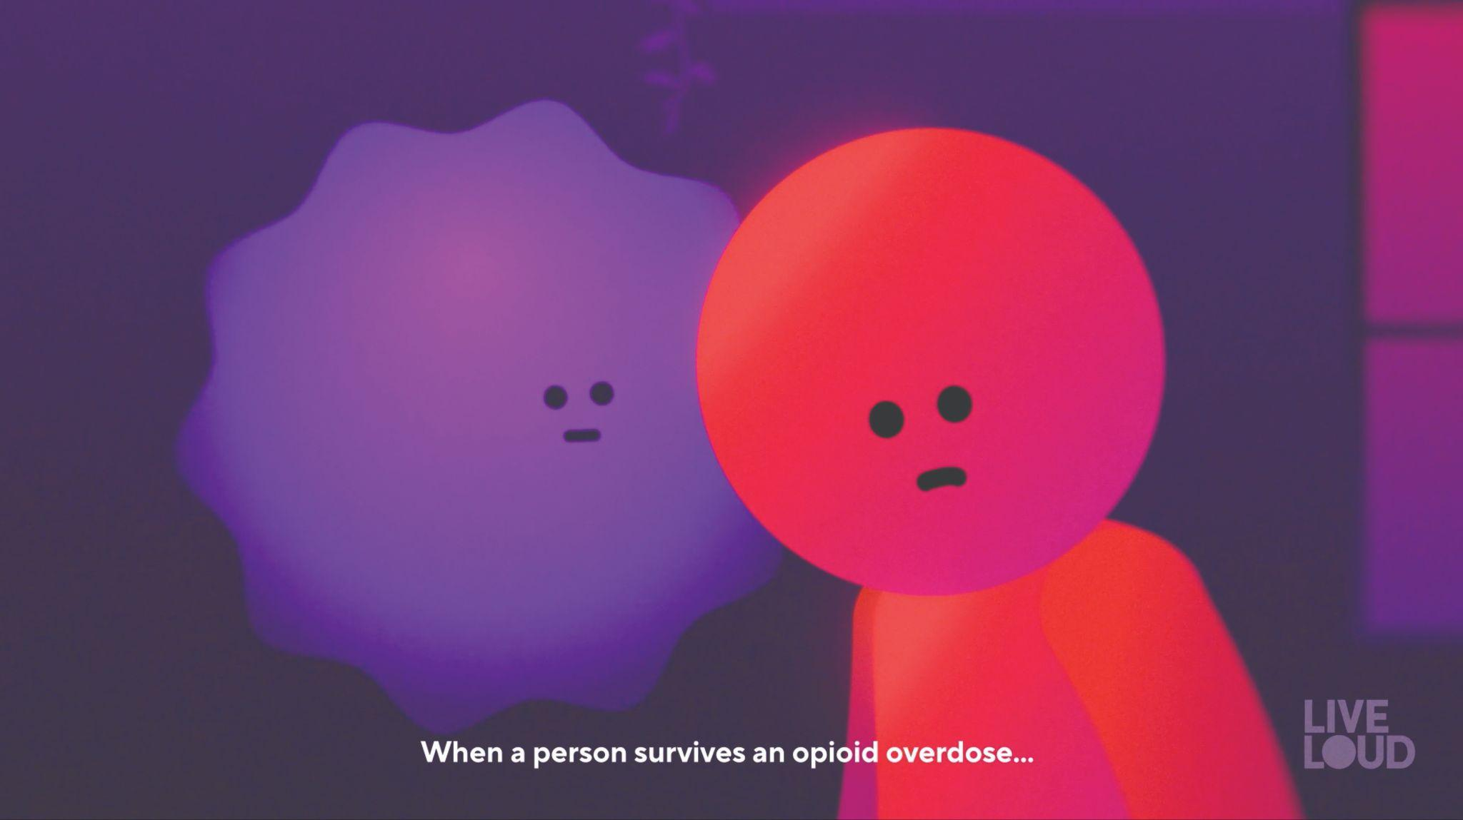

liveLOUD
Nobody Chooses Addiction
Love is Bigger
Than Addiction
Don’t
Use Alone
A New Chance
Every Day

Slide 16
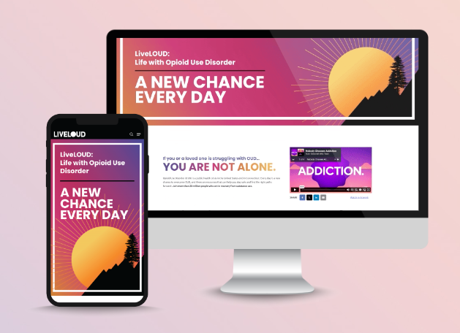
liveLOUD.org
53k
new users

Slide 17





liveLOUD awards

Slide 18
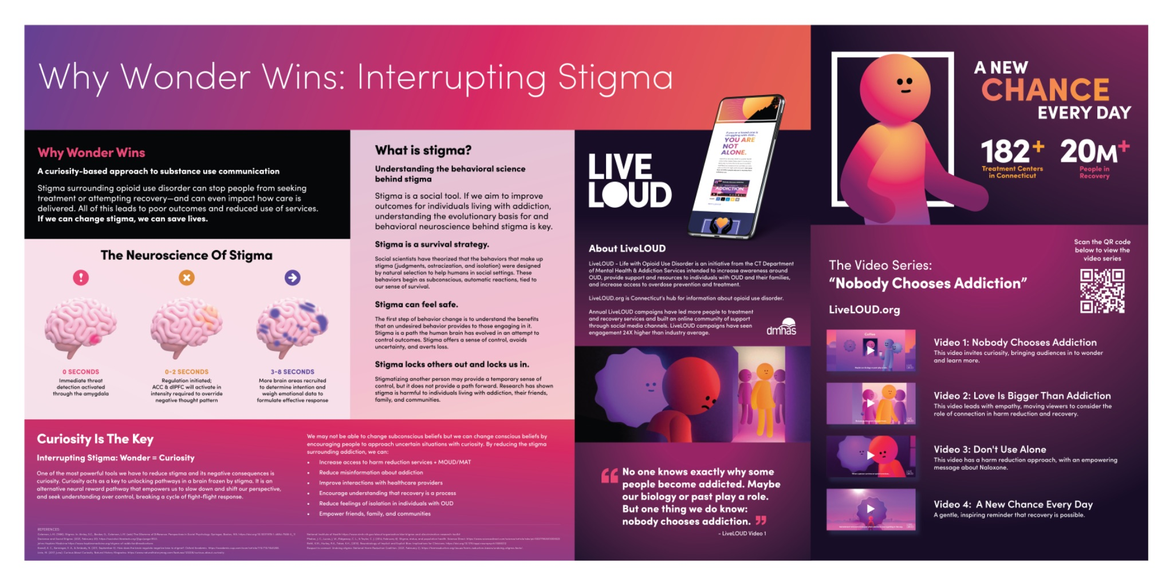
liveLOUD awards

Slide 19
liveLOUD
16m
campaign impressions
1.2m
campaign engagements
60k
naloxone kits
distributed
100s
of lives
saved

Slide 20
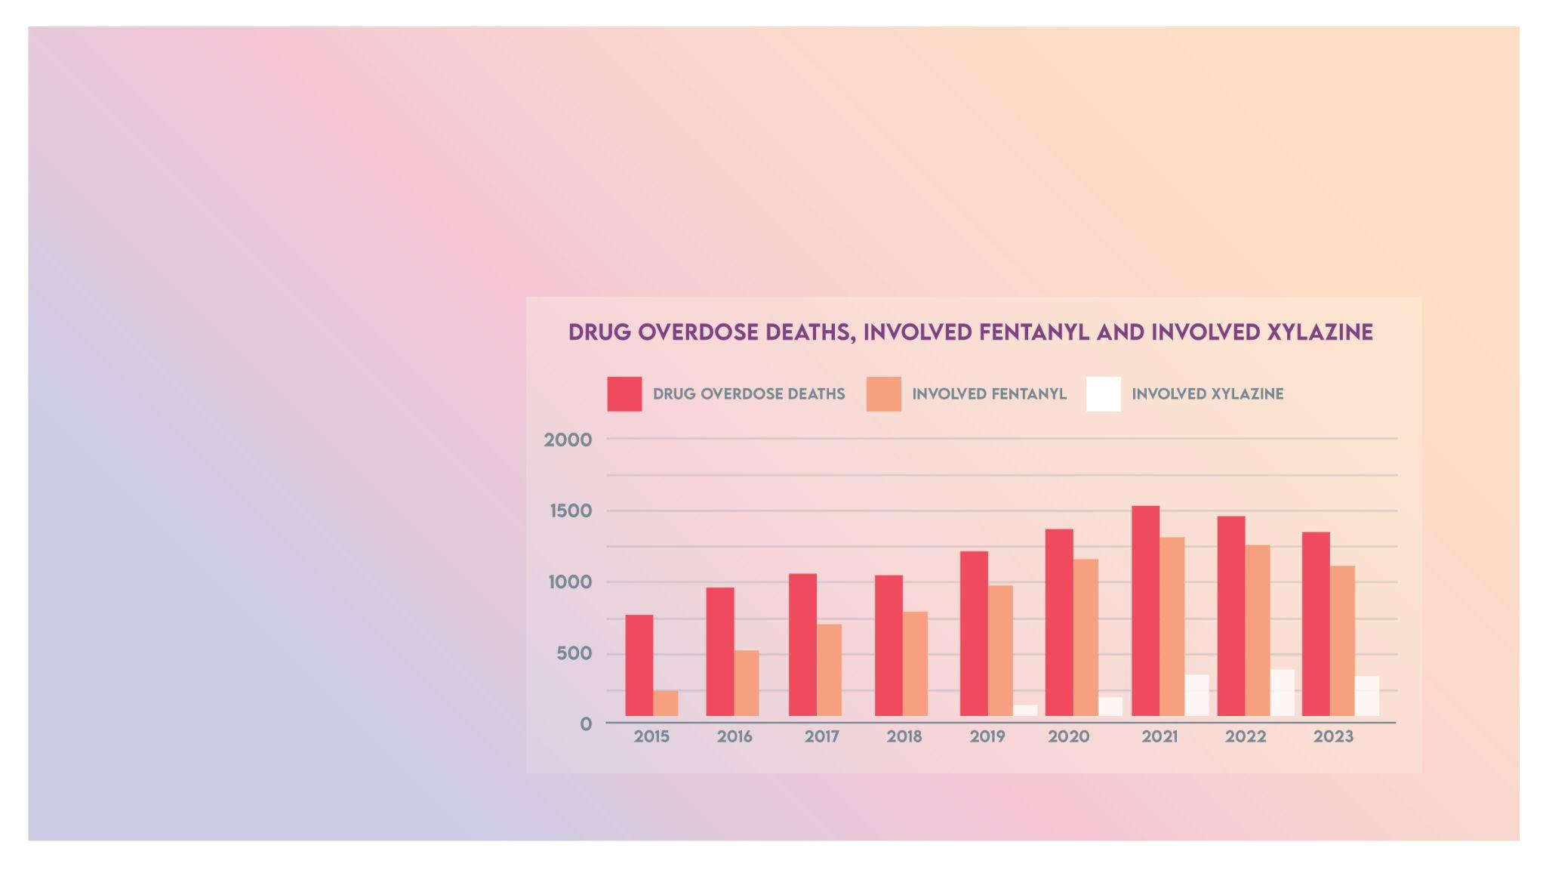
overdose deaths receding
81,083
national overdose deaths 2023
1,342
Connecticut overdose deaths 2023
source

Slide 21
expanded
liveLOUD campaign

Slide 22
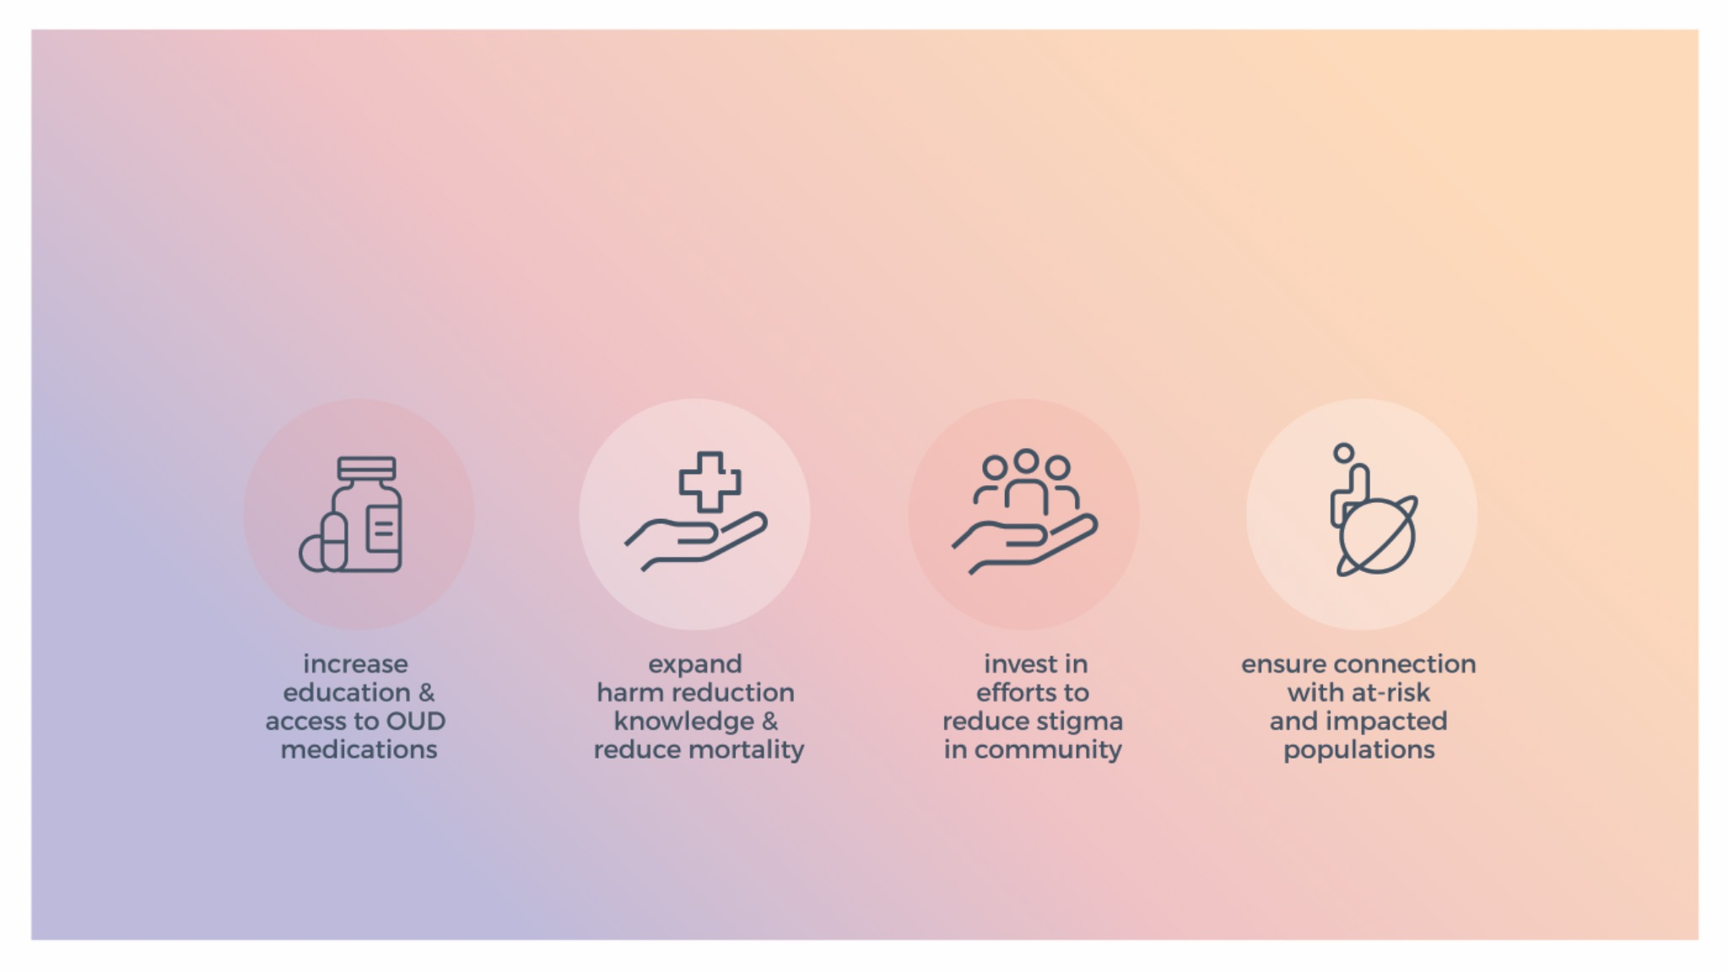
the future
of liveLOUD

Slide 23
maximize impact
reach & frequency
reach all audiences across multiple channels with a
range of messages
engagement
Interact and build relationships with audiences
action
empower audiences with simple next steps to take

Slide 24
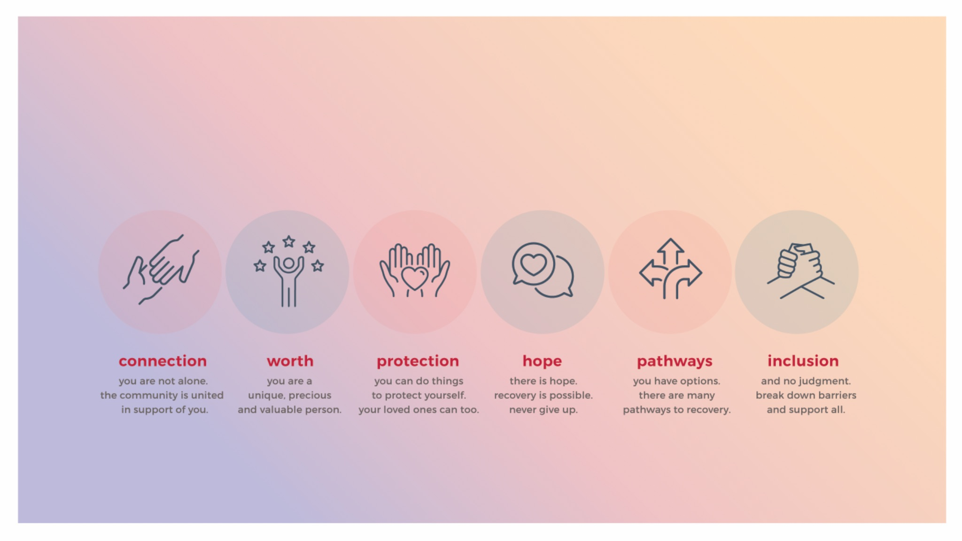
maximize messaging

Slide 25



liveLOUD

Slide 26
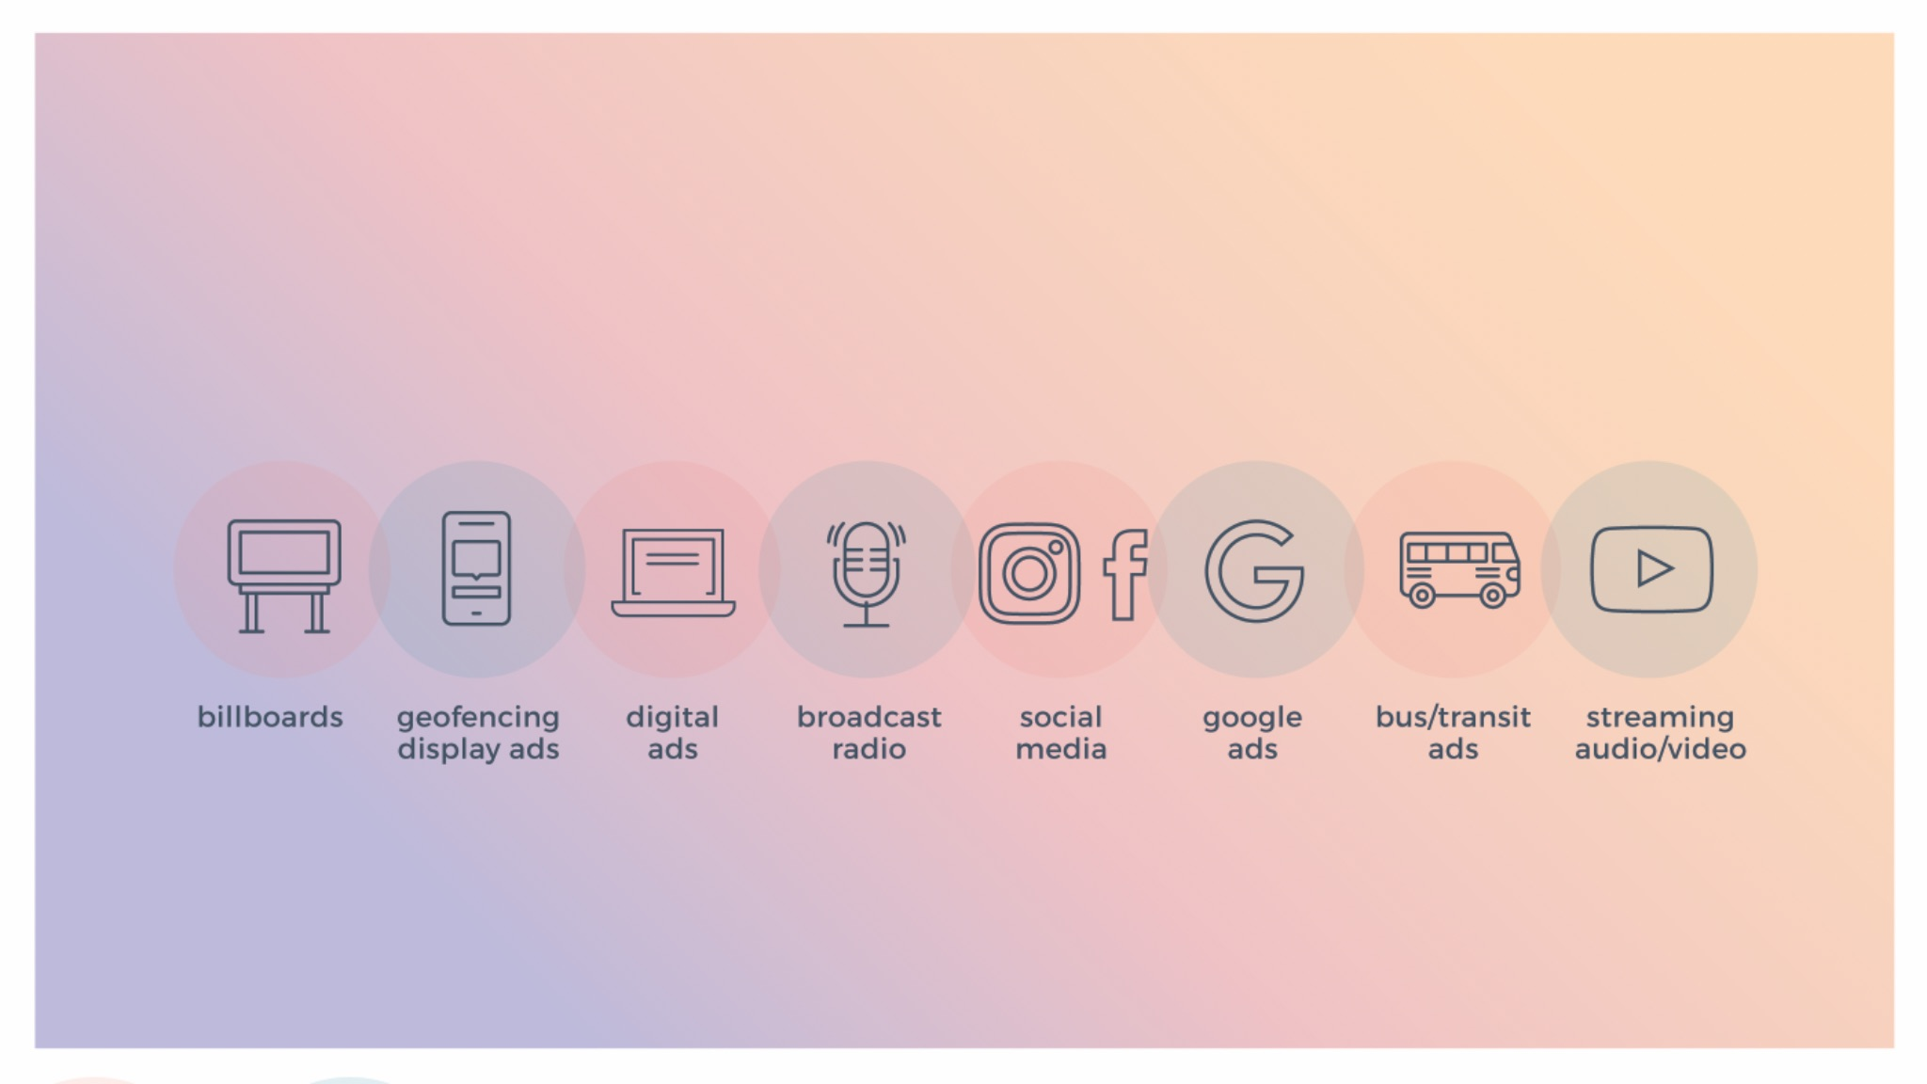
maximize
media

Slide 27
tracking & reporting
Brand Awareness (reach and impressions)
Engagement (how users are interacting with content)
Traffic Performance (clicks, web activity, pages viewed)

Slide 28
liveLOUD.org

Slide 29
WWW.LIVELOUD.ORG
thank you

