Slide 2
May 25-26, 2016 Ozone Exceptional Event Demonstration for Connecticut
Michael Geigert
SIPRAC May 2017

Slide 3

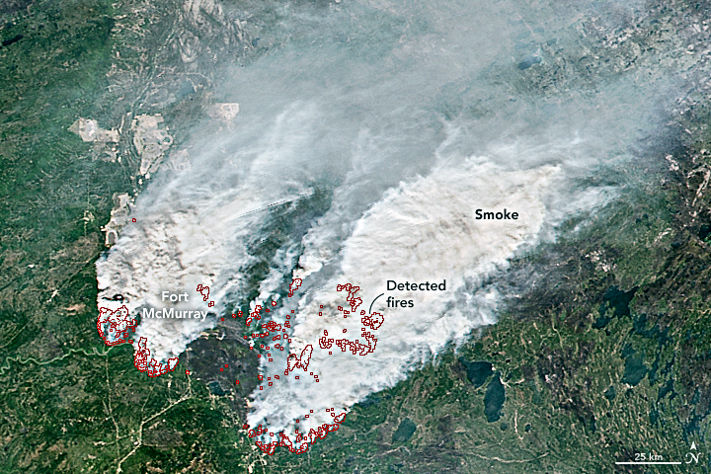
Fort McMurray Wildfire
Oil Sands
On May 1, 2016, a wildfire began southwest of Fort McMurray, Alberta, Canada. On May 3, it swept through the community, destroying approximately 2,400 homes and buildings and forcing the largest wildfire evacuation in Albertan history. The fire spread across approximately 590,000 hectares (1,500,000 acres) before it was declared to be under control on July 5, 2016.

Slide 4
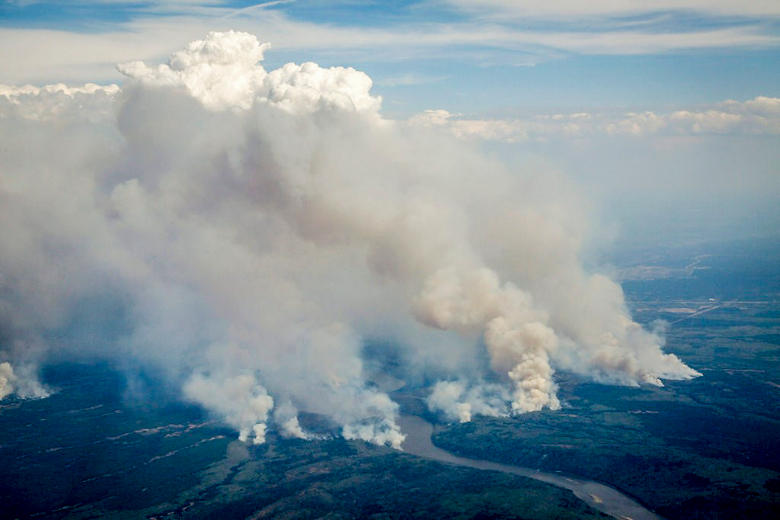
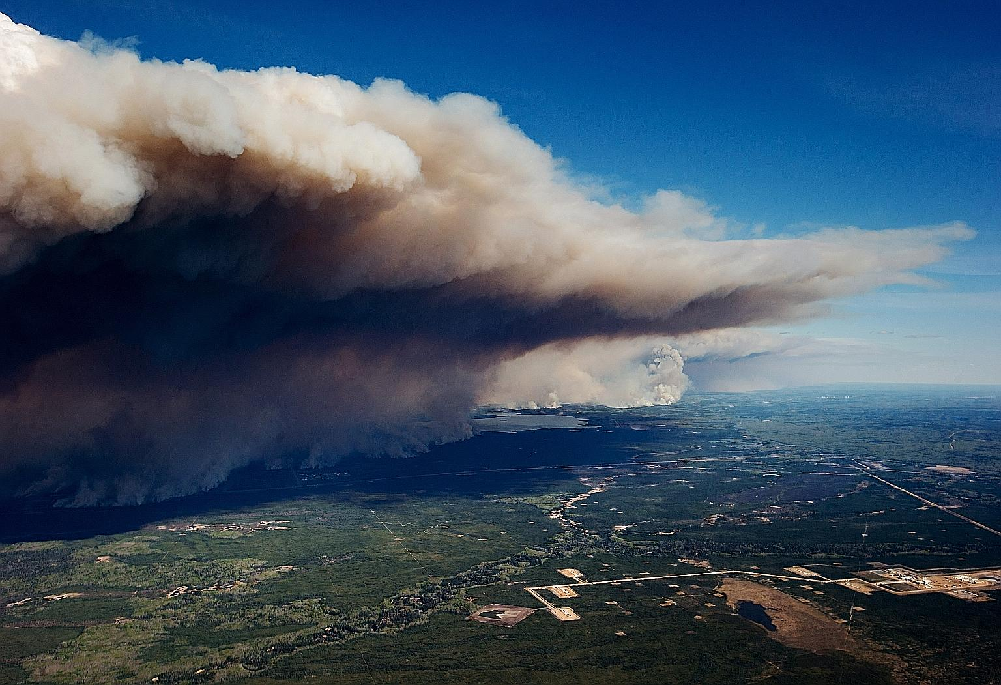
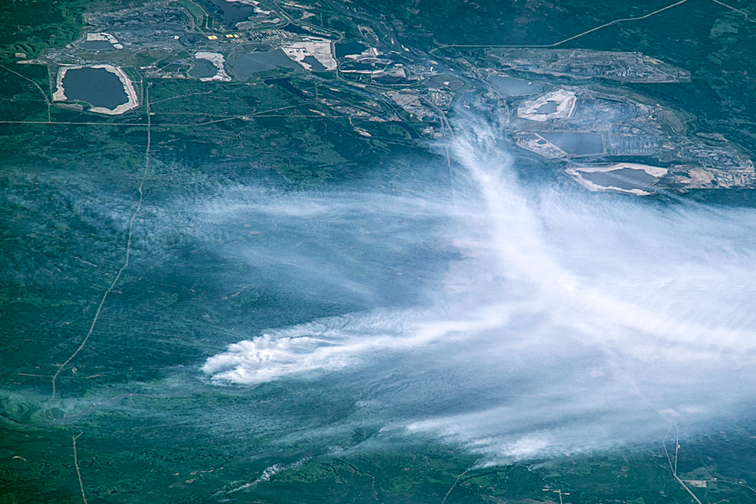
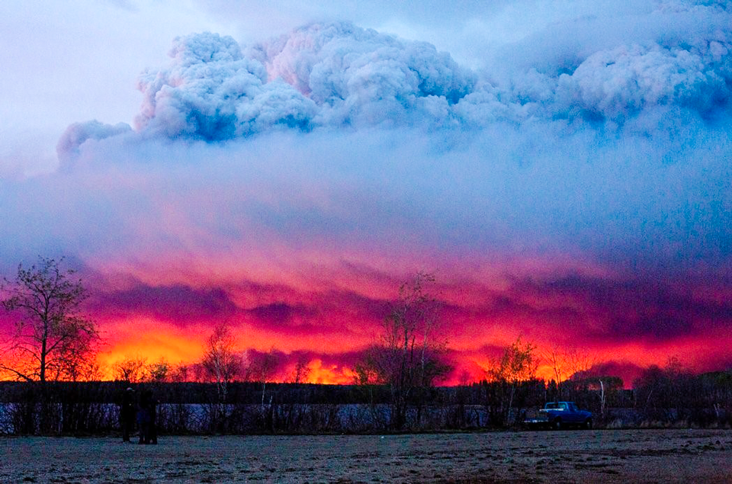
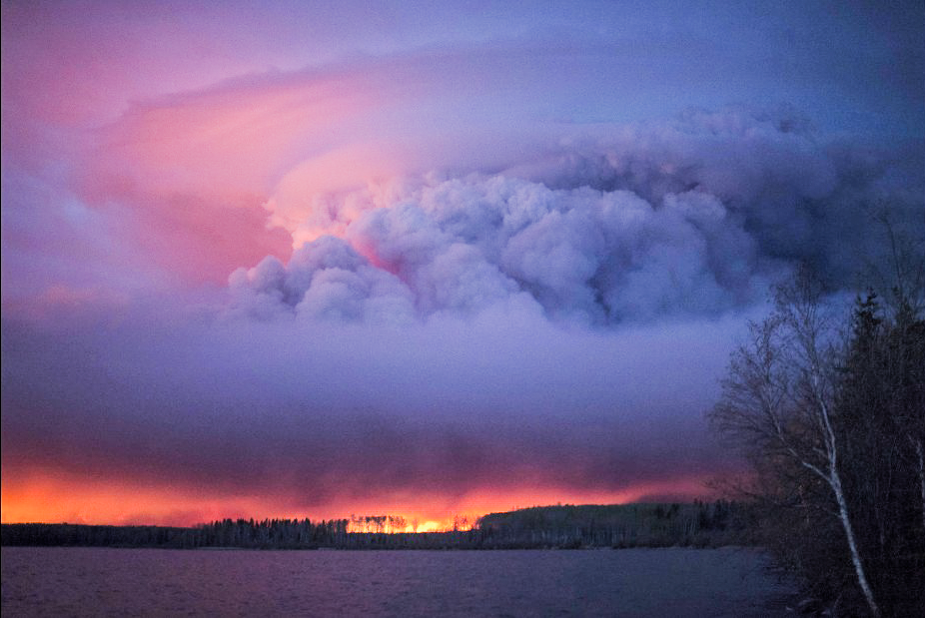
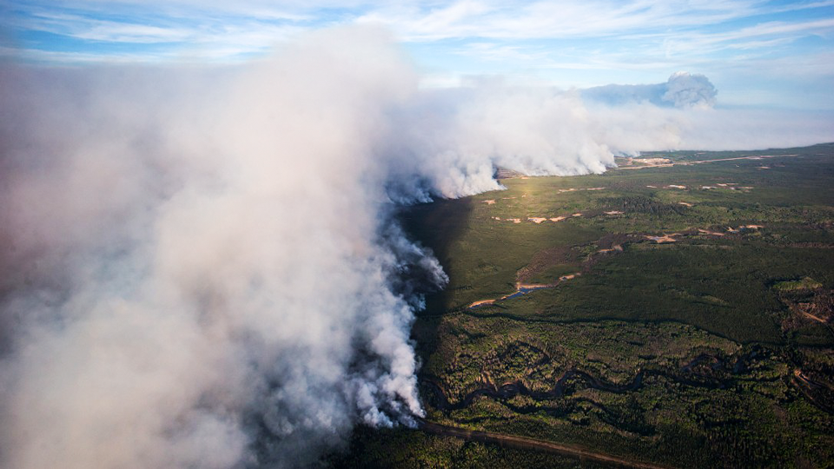
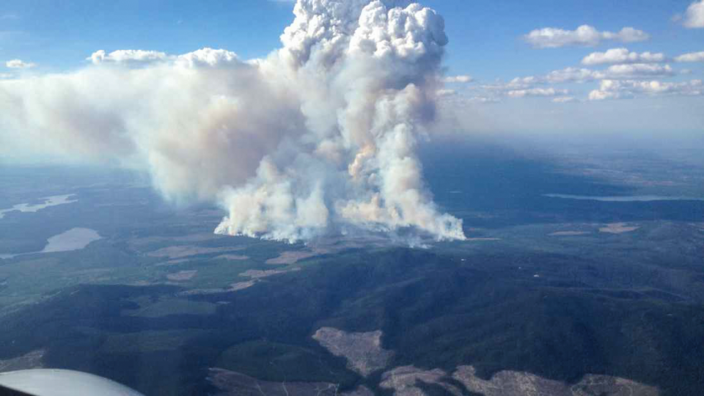
Fort McMurray Wildfire Images

Slide 5
2016 Exceptional Events Rule
On September 16, 2016, the U.S. Environmental Protection Agency (EPA) finalized revisions to the 2007 Exceptional Events Rule. An exceptional event demonstration should include the following:
1) A narrative conceptual model that describes the event(s) causing the exceedance or violation and a discussion of how emissions from the event(s) led to the exceedance or violation at the affected monitor(s);
2) A demonstration that the event affected air quality in such a way that there exists a clear causal relationship between the specific event and the monitored exceedance or violation;
3) Analyses comparing the claimed event-influenced concentration(s) to concentrations at the same monitoring site at other times. The Administrator shall not require a State to prove a specific percentile point in the distribution of data;
4) A demonstration that the event was both not reasonably controllable and not reasonably preventable;
5) A demonstration that the event was caused by human activity that is unlikely to recur at a particular location or was a natural event; and
6) Documentation that the submitting air agency followed the public comment process.

Slide 6
May 2017 Review and Update
Notification Letter to EPA Region 1, for May 2016 Potential Exceptional Event
  Submitted on September 28, 2016
  Originally included May 25-28 and all Connecticut monitors
EPA Response to CT Exceptional Event Request
  Established deadline of May 31, 2017 for submittal of final demonstration
  Required a 30-day public comment period before final submission
Notice of Intent to Submit an Exceptional Event Demonstration to EPA and Opportunity for Public Comment
  For the four most critical monitors on May 25-26th
  Issued on April 18th, 2017 and notification sent to stakeholders
  Comments due by 4:30 PM on May 19, 2016
Technical Support Document for Exceptional Event Analysis- DRAFT FOR PUBLIC COMMENT

Slide 7
Maximum Daily 8-hr Ozone Averages
The maximum 8-hour average ozone concentration in parts per billion (ppb) for each ozone monitoring site in Connecticut during the four day May 2016 ozone event. Data for Connecticut’s Greenwich monitor has been invalidated.
Site Name | 5/25/2016 | 5/26/2016 | 5/27/2016 | 5/28/2016
Abington | 76 | 83 | 68 | 67
Cornwall | 81 | 91 | 78 | 65
Danbury | 82 | 99 | 81 | 81
East Hartford | 75 | 93 | 70 | 81
Groton | 87 | 80 | 54 | 60
Madison | 89 | 86 | 56 | 63
Middletown | 80 | 91 | 67 | 79
New Haven | 63 | 84 | 65 | 73
Stafford | 74 | 82 | 70 | 73
Stratford | 89 | 76 | 59 | 70
Westport | 87 | 90 | 61 | 81
May 25-26th had the most impact on current design values, so requested these 2 days.

Slide 8
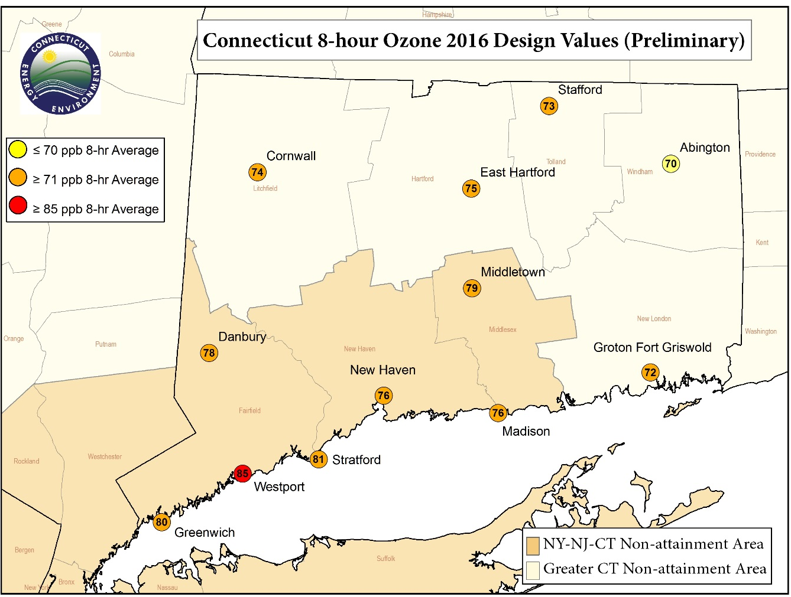
Monitors Selected for Data Exclusion
Elevation: 513 m (1683 ft)
Greenwich data invalidated,
Design value may change

Slide 9
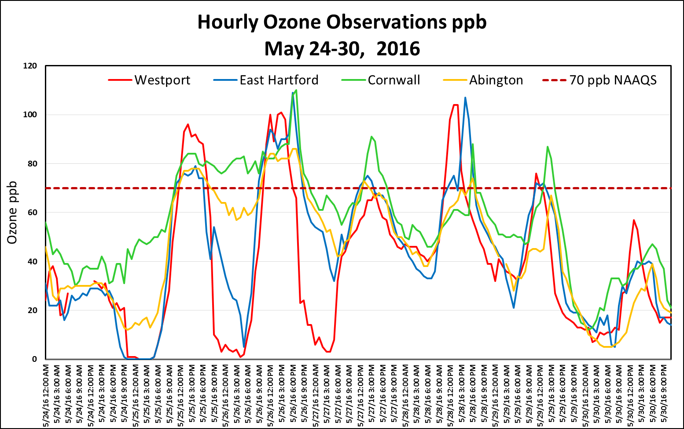
Hourly Ozone May 24-30, 2016
Hourly Ozone Concentrations for May 24-30, 2016 for Requested Data Exclusion Sites.

Slide 10
Attainment Status Affected
Comparison of 2016 Design Values with and without May 25 and 26, 2016 Data, and Corresponding 2017 Critical 4th High Values at the Four Sites Proposed for Exclusion.
Critical 4th high is the value at which the monitor will exceed the NAAQS (in parenthesis) for the 2017 season.
Current Values |  |  |  |  |  | Revised Values Excluding May 25-26, 2016
Site Name | 4th high 2014 | 4th high 2015 | 4th high 2016 | 2014-2016 DV | 2017 Critical 4th High Value (NAAQS Standard) | 4th high 2016 | 2014-2016 DV | 2017 Critical 4th High Value (NAAQS Standard)
Abington | 67 | 70 | 74 | 70 | 69 (70) | 67 | 68 | 76 (70)
Westport | 81 | 87 | 87 | 85 | 81 (84) | 81 | 83 | 87 (84)
Cornwall | 68 | 76 | 78 | 74 | 74 (75) | 74 | 72 | 78 (75)
East Hartford | 77 | 75 | 75 | 75 | 78 (75) | 72 | 74 | 81 (75)

Slide 11

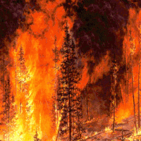
Weight of Evidence
CONCEPTUAL MODEL: Typical exceedance day meteorology (I-95 corridor);
PROOF OF TRANSPORT:
  Evidence that wildfire emissions to the influenced monitors, including meteorological information regarding the transport of wildfire emissions to the monitor;
  Satellite imagery and smoke plume analysis that shows the Fort McMurray plume moving to the Great Lakes area producing high concentrations before being transported to Connecticut;
  Hysplit trajectory analysis showing the plume originated from Fort McMurray;
SIMILAR DAY ANALYSIS: Finding examples of other days when upper level wind flow and back trajectories were similar to the those of the event and yet produced GOOD air quality;
MONITORING DATA: Producing data from local and regional monitors that show that aerosols and other pollutants from the plume were present;
MODELING: Showing that the NOAA operational ozone model, which did not incorporate real time wildfire emissions into the inventory, was under predicting ozone levels at the onset by at least 20-30 ppb;

Slide 12
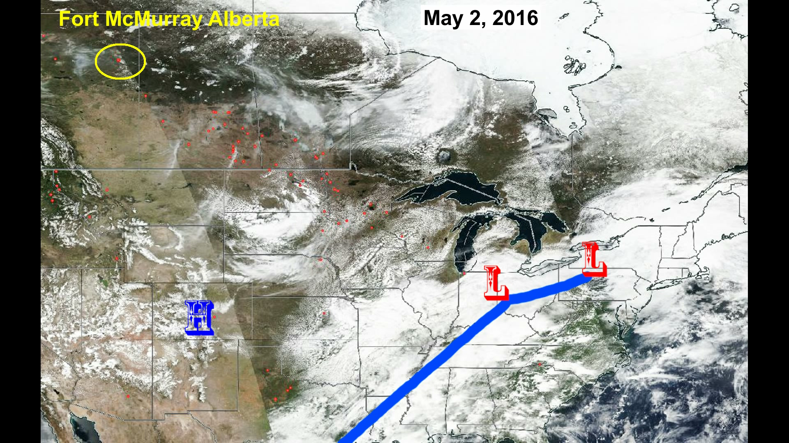
Video of Wildfire Evolution from May 2th, 2016
Click to animate

Slide 13
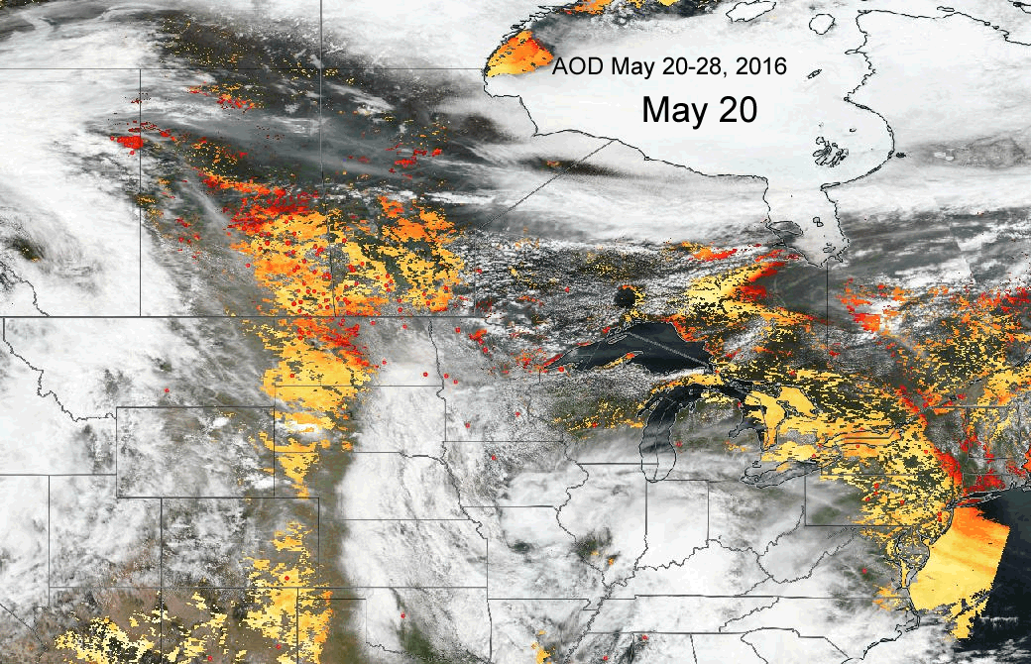
May 20-28 AOD Satellite Animation
Orange and red AOD signify
Higher aerosol concentrations in
Total vertical column (not surface)

Slide 14

Smoke Plume Animation from May 18th- May 28th
(Click to animate)

Slide 15
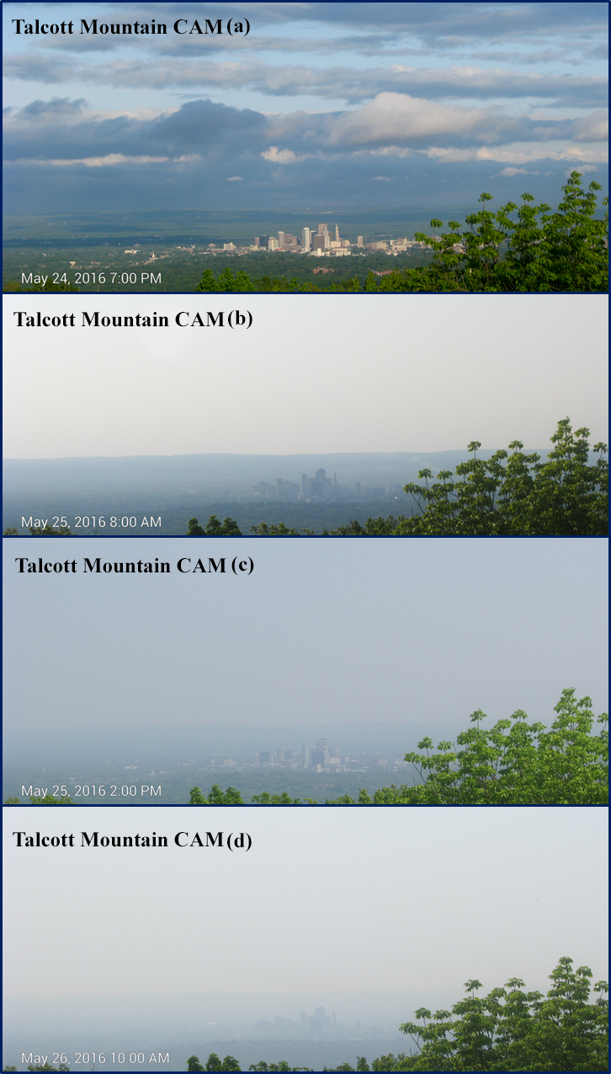
Haze Cam May 24-26, 2016
Talcott Mountain CAM looking towards Hartford;
Clear skies on May 24th give way to smoky haze on May 25-26th.

Slide 16
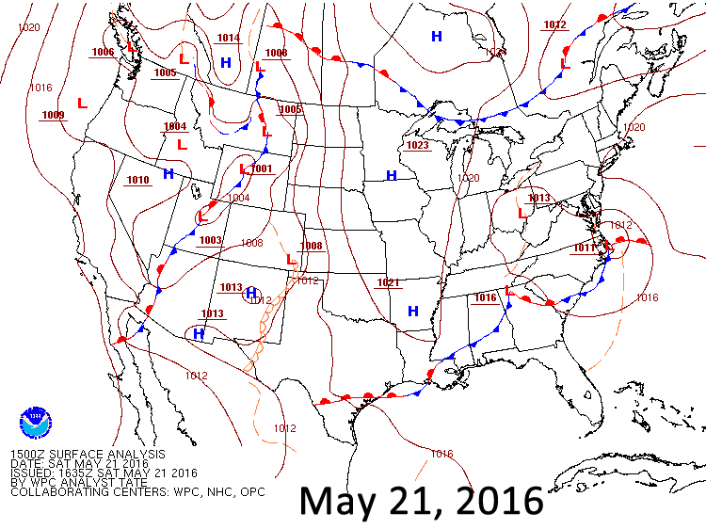
Surface Animation May 21-26, 2016
On May 21, 2016, the plume began dispersing towards the upper Midwest and Great Lakes, where it was trapped beneath a dome of high pressure

Slide 17
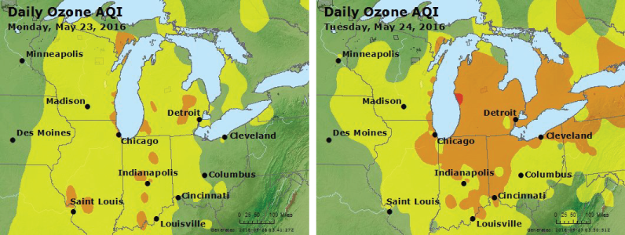
Part 1: Ozone Formation over Midwest
Ozone AQI Maps for May 23-24, 2016.

Slide 18
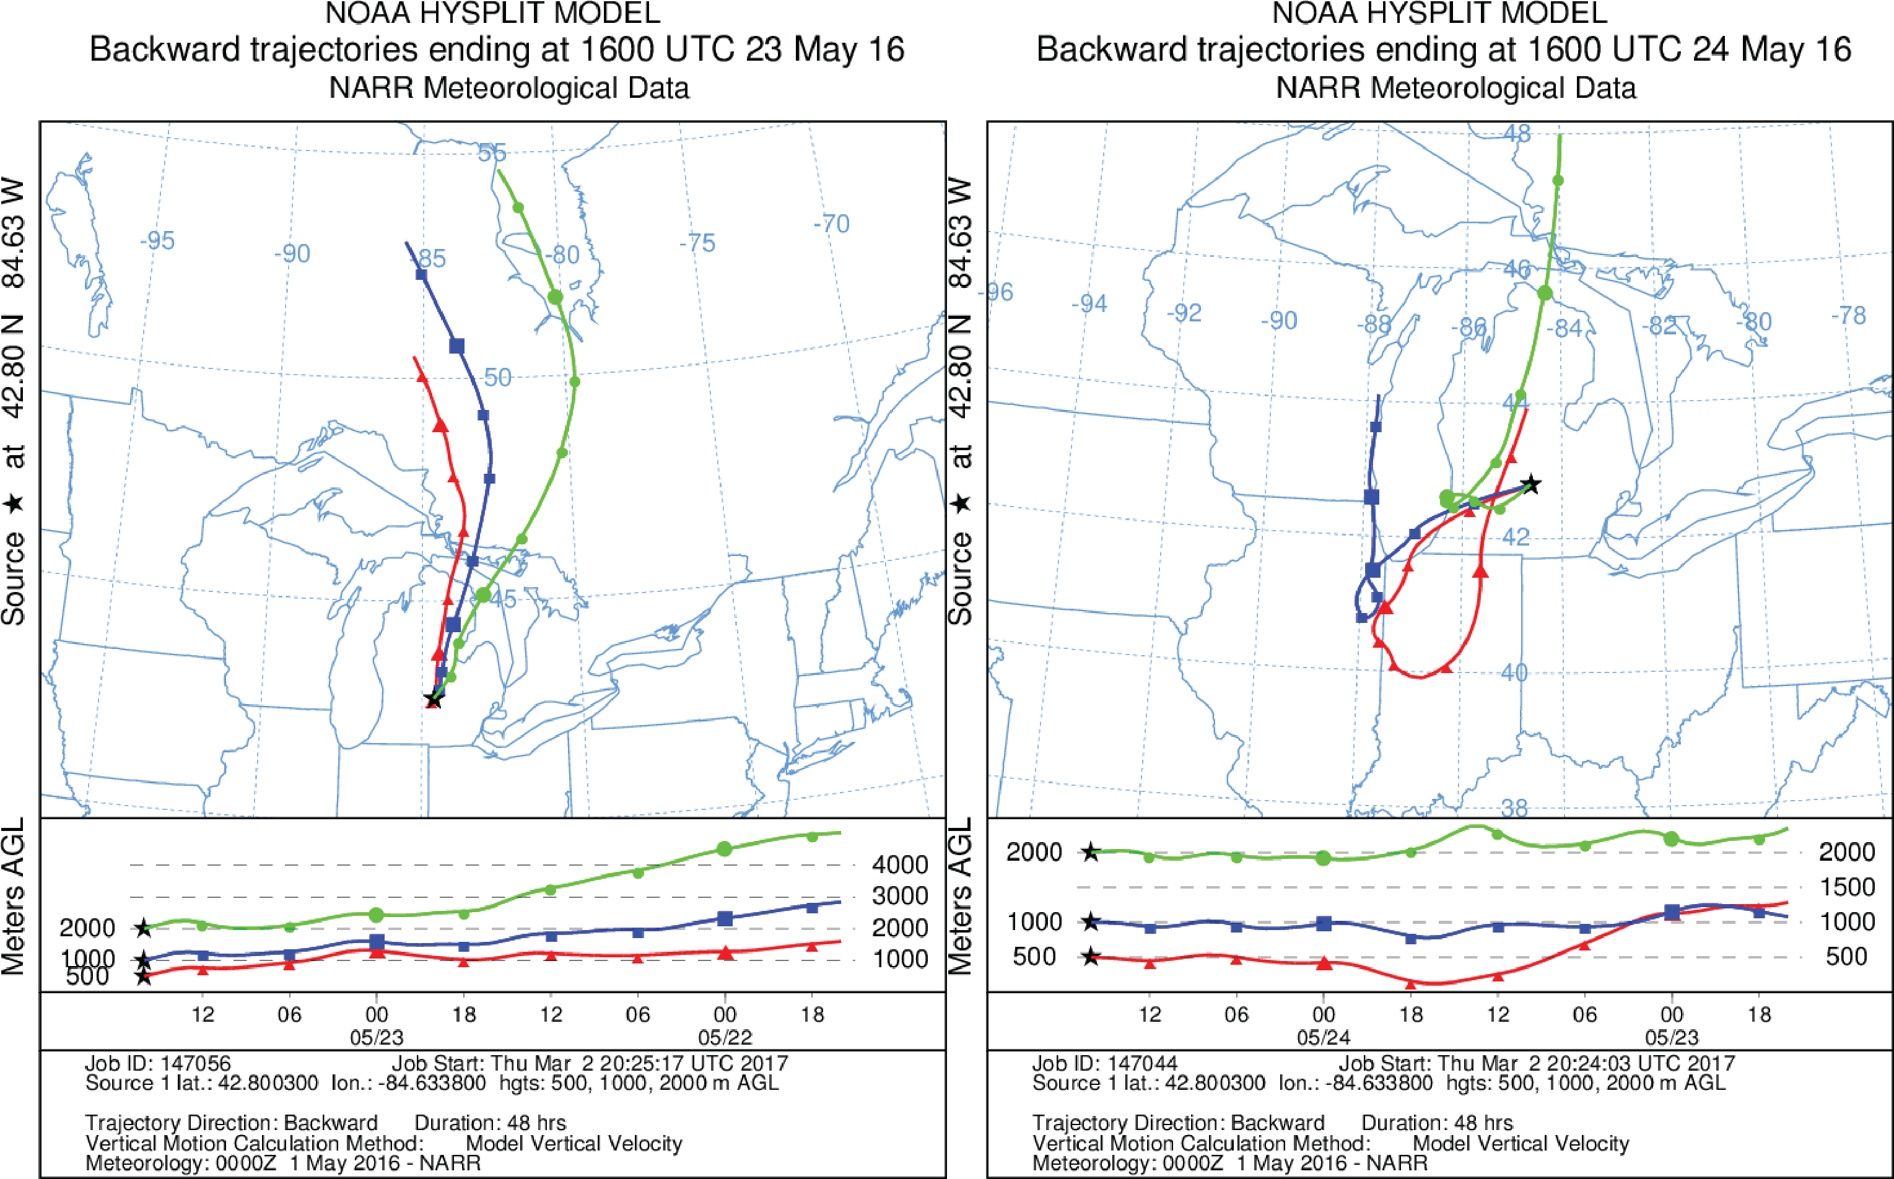
Hysplit Back Trajectories
HYSPLIT Back Trajectories from Michigan, May 23- 24, 2016

Slide 19
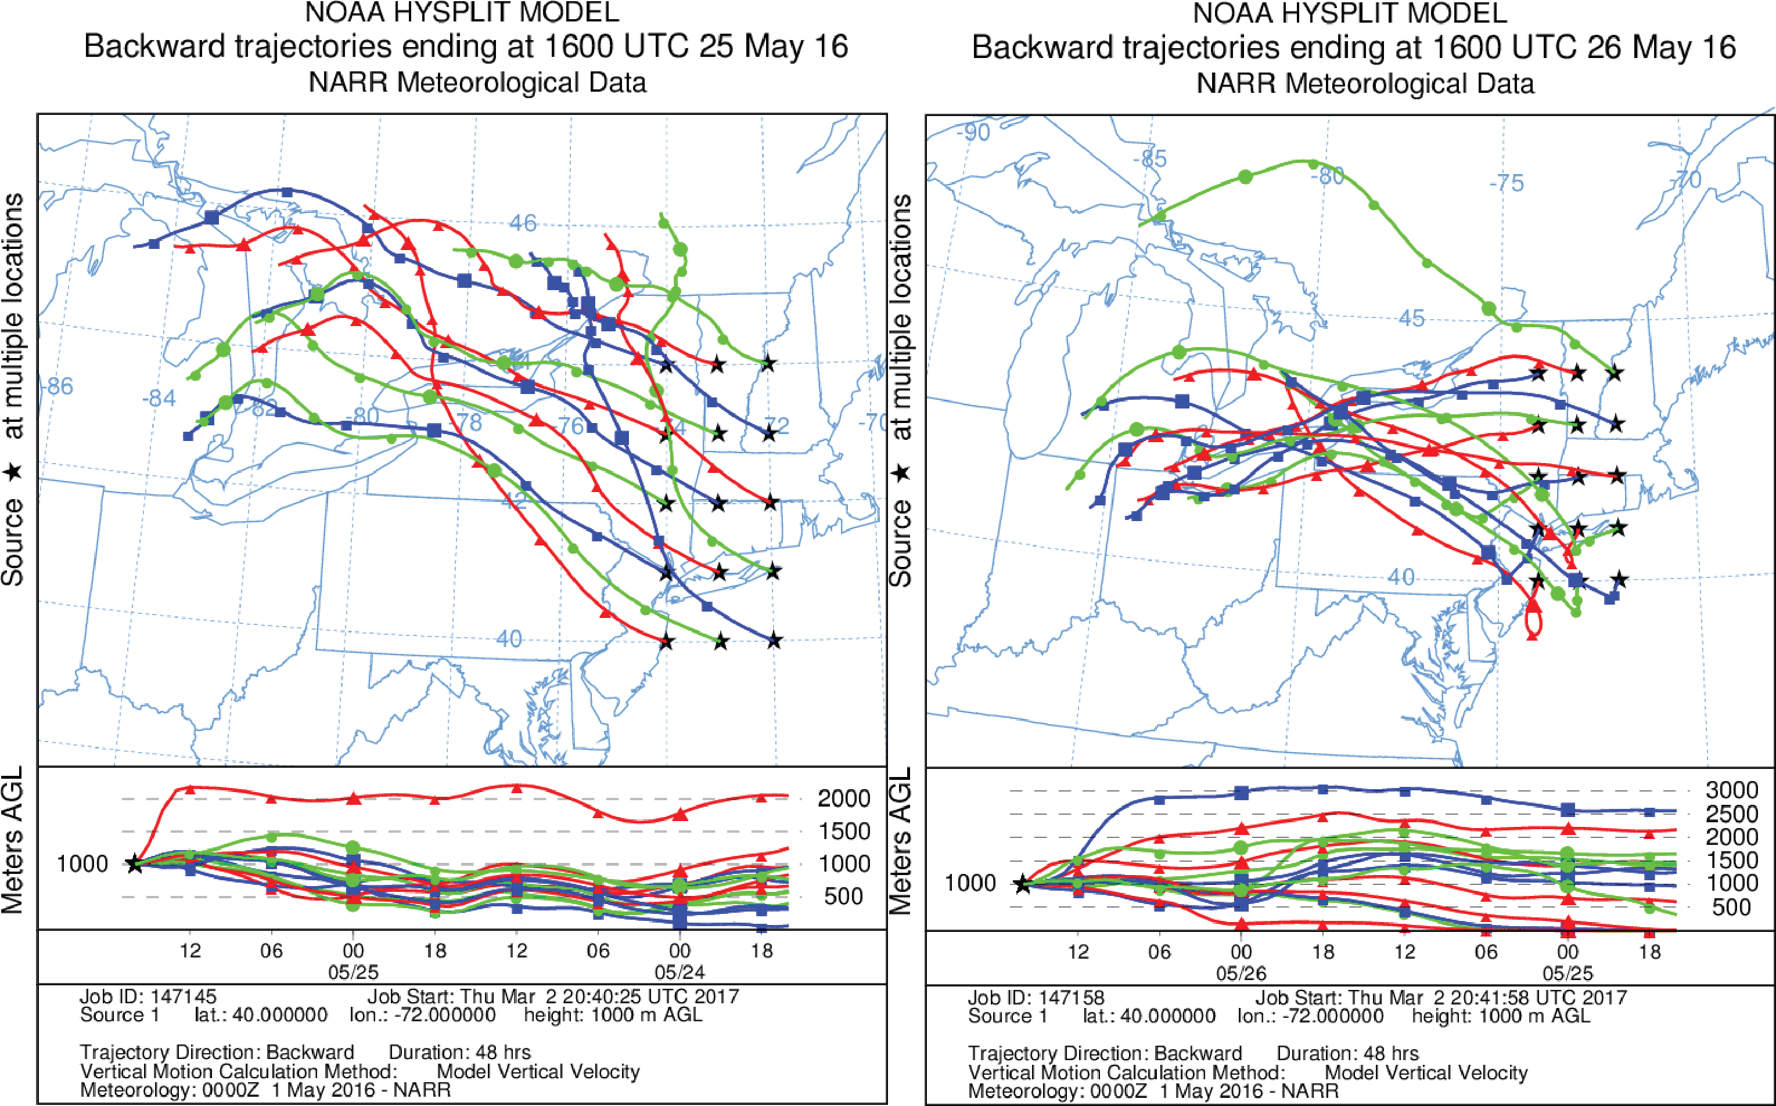
1000 meter Hysplit Back Trajectories
HYSPLIT 48-hour Back Trajectories from New England (left) May 25, 12:00EDT, (right)May 26, 12:00EDT.

Slide 20
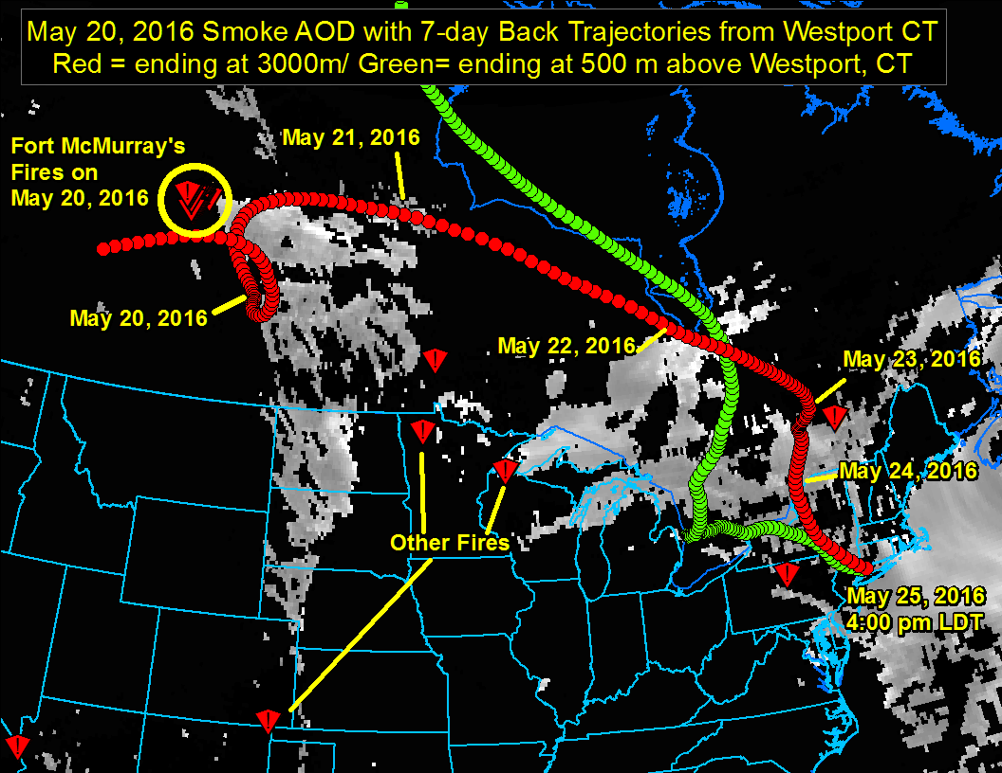
Back Trajectories from Westport from Fort McMurray
Hourly Back Trajectories ending at 4:00 pm LDT on May 25th with Fire Locations and Satellite AOD from May 20th, showing Path of Transport of Smoke Plume Pollutants to Westport CT.

Slide 21
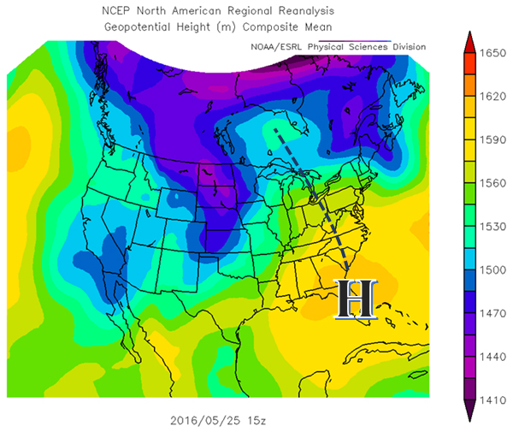
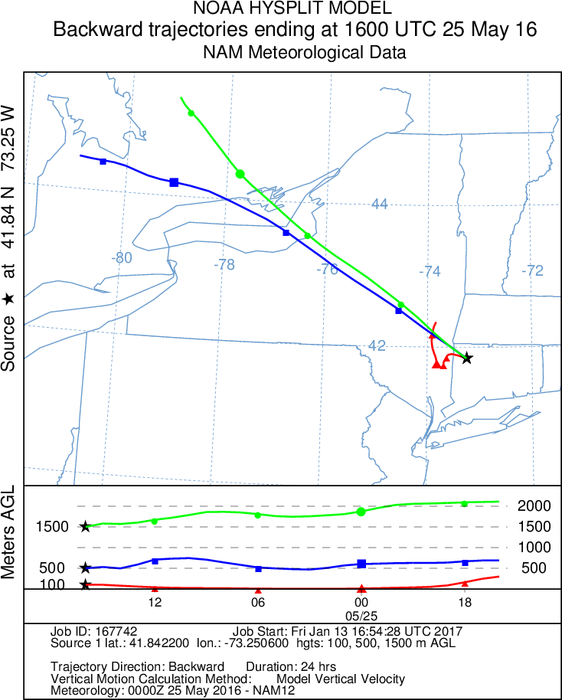
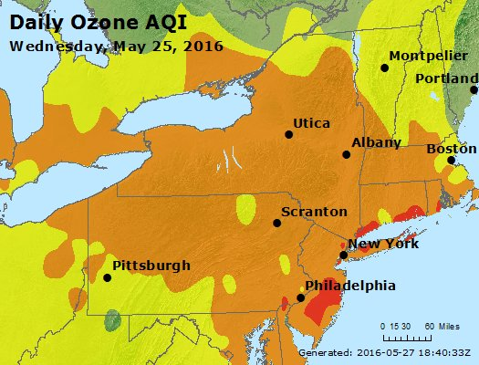
Similar Day Analysis- May 25th Pattern
850 mb Reference Pressure Pattern for May 25th, 2016

Slide 22
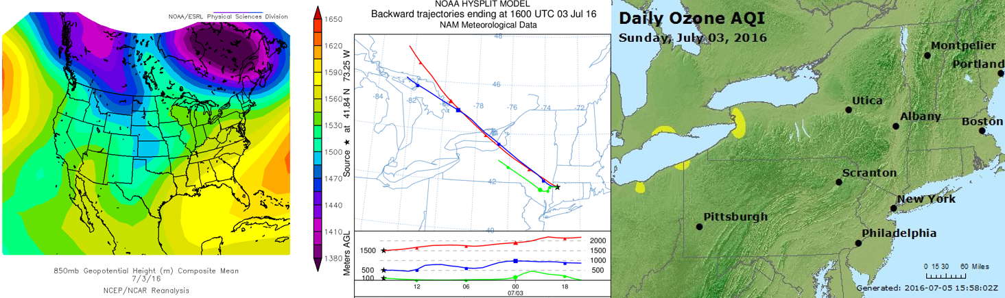
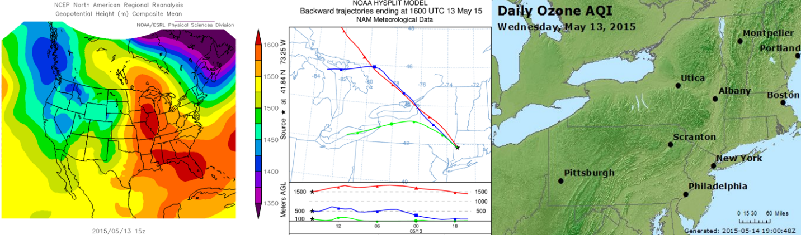
Similar Day Analysis
GOOD Air Quality
GOOD Air Quality

Slide 23
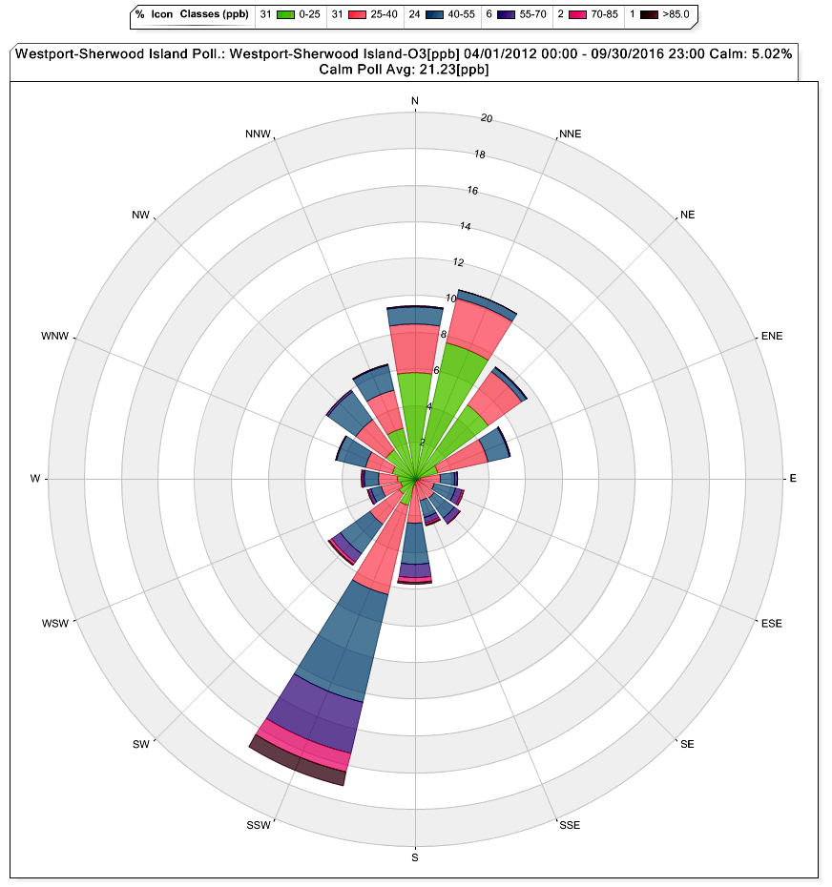
Westport Ozone Wind Rose
Monitored ozone from April-September 2012-2016;
Predominant wind is from southwest;
Highest ozone levels from southwest and highest proportion of GOOD air quality from same sector.
GOOD Air Quality
USG+ Air Quality

Slide 24
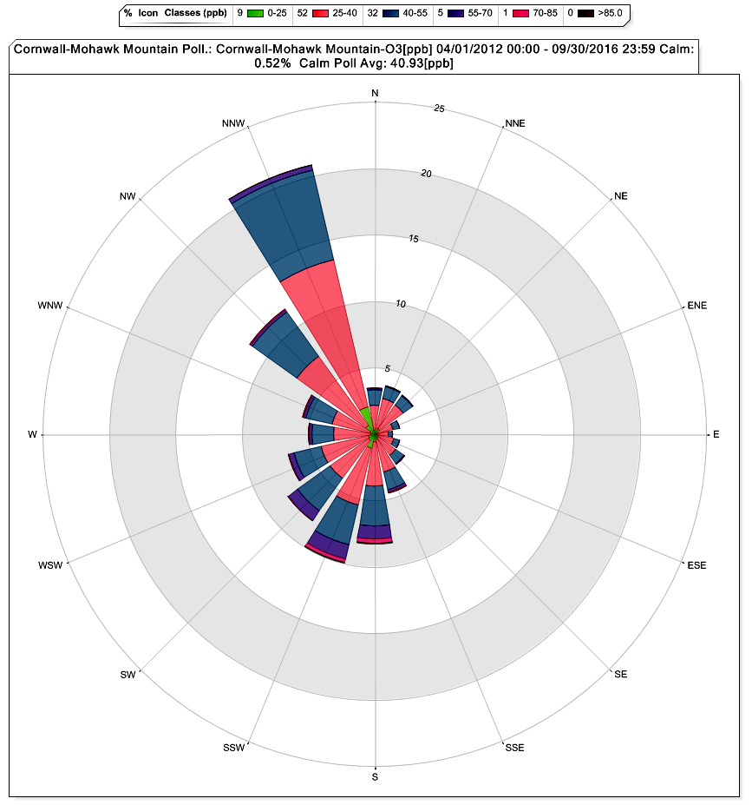
Cornwall Ozone Wind Rose
Monitored ozone year-round 2012-2016;
Predominant wind is from northwest;
Highest ozone levels from southwest and highest proportion of GOOD air quality from the northwest quadrant.

Slide 25
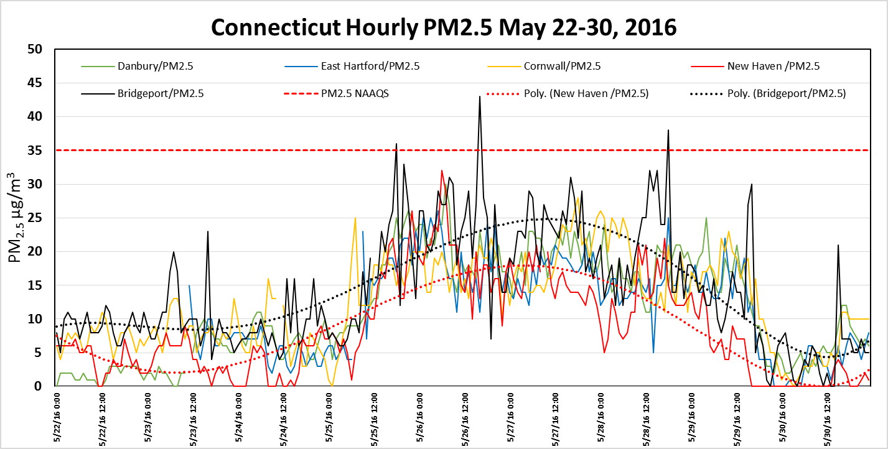
Pollutant Charts: May 22-30, 2016 PM2.5
Plots of monitored PM2.5 show elevated levels throughout the State from May 25-May 28th

Slide 26
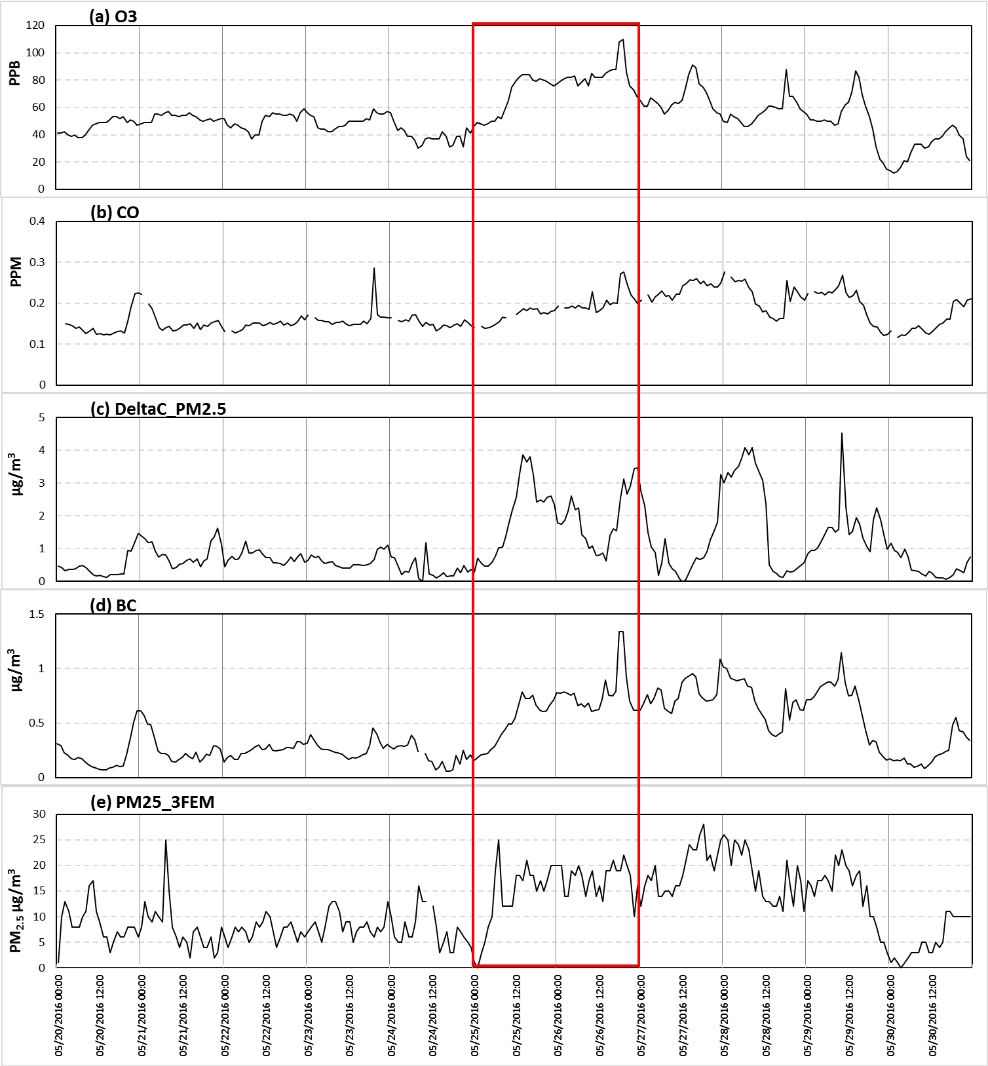
Cornwall Ozone, CO, Delta C, BC and PM2.5
70 ppb
Pollutants show a marked increase on May 25-26th, along with the elevated ozone.

Slide 27
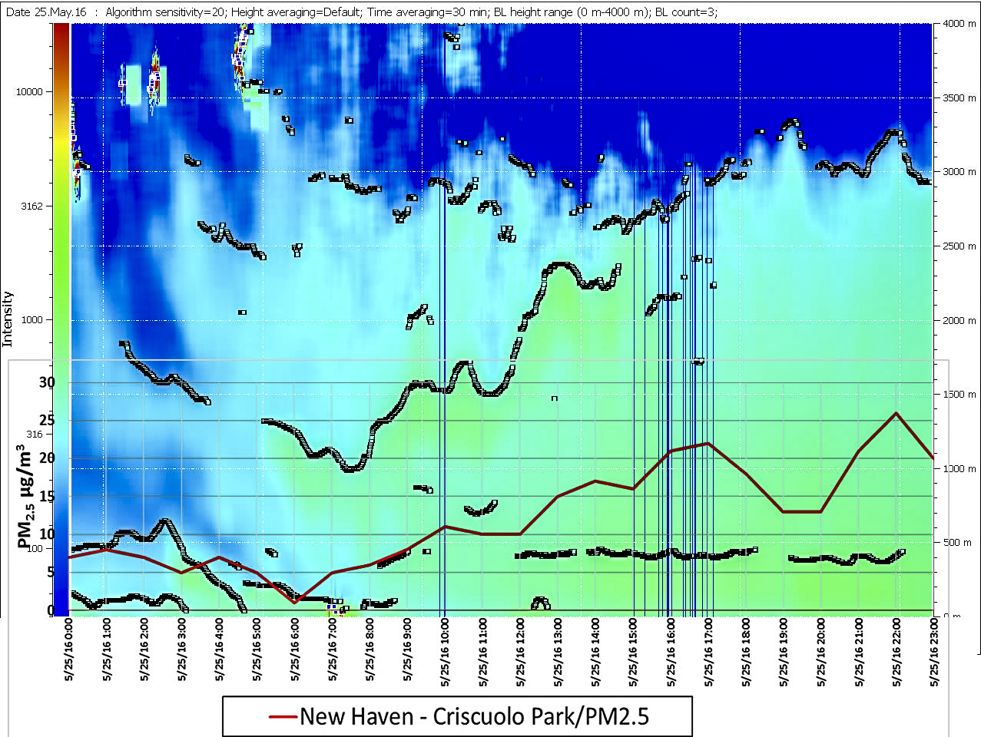
New Haven Ceilometer Back Scatter Aerosols
Thick aerosol layer moves over New Haven after 6:00 am LST with mixing layer exceeding 3000 meters during the afternoon.

Slide 28
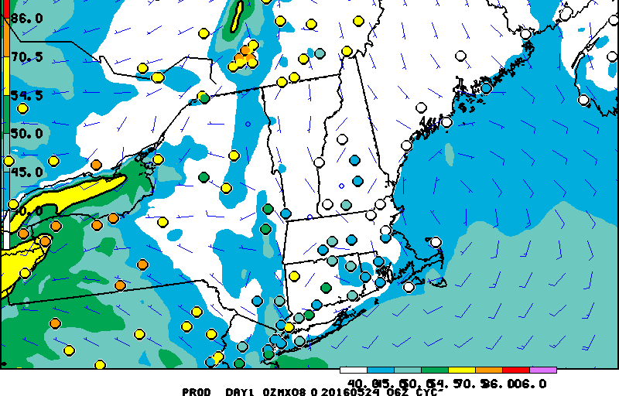
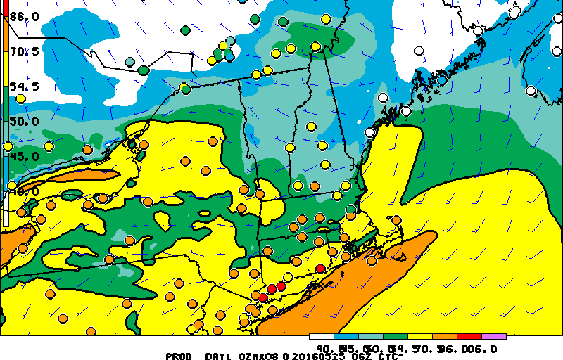
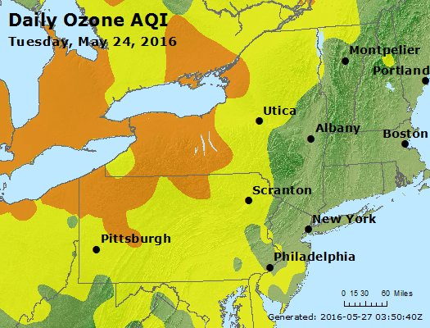

NE States NOAA Model/ AQI Observed

Slide 29
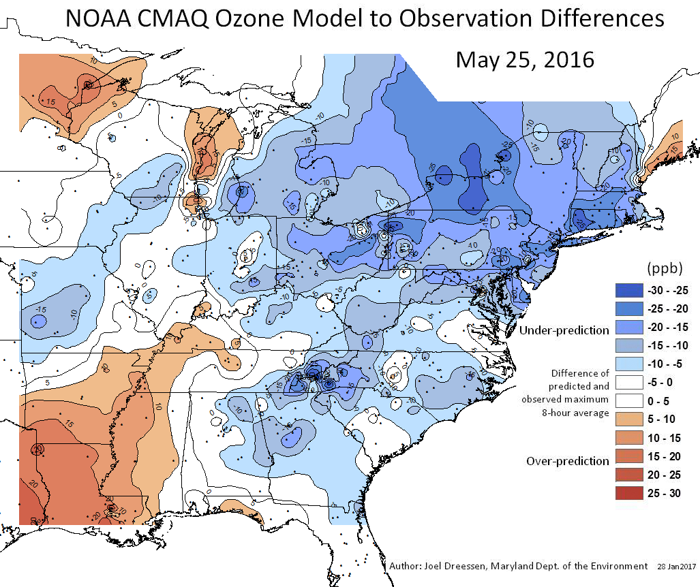
Eastern States NOAA Model Bias
NOAA CMAQ Model Bias Isopleths for May 25, 2016

Slide 30
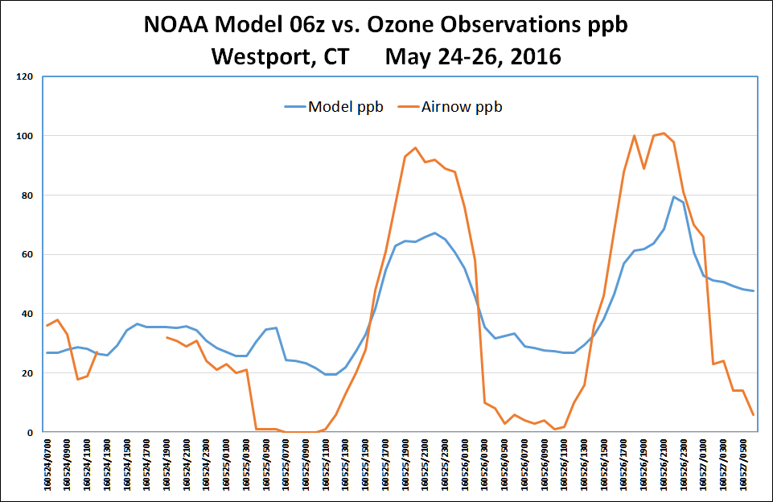
Westport CT NOAA Model vs. Observations
Westport CT NOAA Model vs. Observed Ozone, May 24-27, 2016

Slide 31
Conclusion
There is no doubt that the Fort McMurray wildfire plume directly affected ozone production in the Great Lakes’ States and that ozone, as well as residual pollutants from the plume, were transported southeastward to enhance ozone production in the northeast States on May 25-26, 2016;
Data should be excluded for those four monitors that have a critical regulatory significance in Connecticut.

